Slide 1

2022 Annual Report

Slide 2
PASTORAL SUMMARY
Calling of A New Pastor
As I reflect on 2022, it’s been a year of anticipating where and how God was leading my family and me. When I met with Pastor Christopher in 2021, I had no idea that that meeting would lead us together. God had ordained every step of our path for us to be here. Since being here, my family and I have received nothing but love and care from you, and we are grateful to be part of a church that loves God and display His generosity so well.
The transition of a senior pastor can be challenging. I want to take this time to acknowledge the stress, anxiety, or hurt this transition has caused for some of you. Changes are never easy, and it affects everyone, not just pastors. I pray for God’s peace and healing to be upon you. I want to assure you that I will do all I can to love you just as Christ loved the church.
Hitting the Ground Running
In my four months, I’ve met with our governing board, both past and present, either individually or in groups. I’ve met with our congregations, coordinators, and church plant team, have attended small group events, mens events, and have visited families for prayer. I have weekly staff and 1:1 meetings with Kongchinh and Blong. I’ve started a newsletter to encourage our church and to share my family adventures. I’ve created a roadmap to help leaders focus on what we will do throughout the year.
Looking Forward
To build a deeper relationship with my governing board, coordinators, and my congregation.
To partner with our nearby churches, city council, schools, and non-profit organizations.
To build relationships with pastors in Sacramento.
To see our church make disciples that make disciples that make disciples.
To grow spiritually and more profound with our relationship with Jesus.

Slide 3
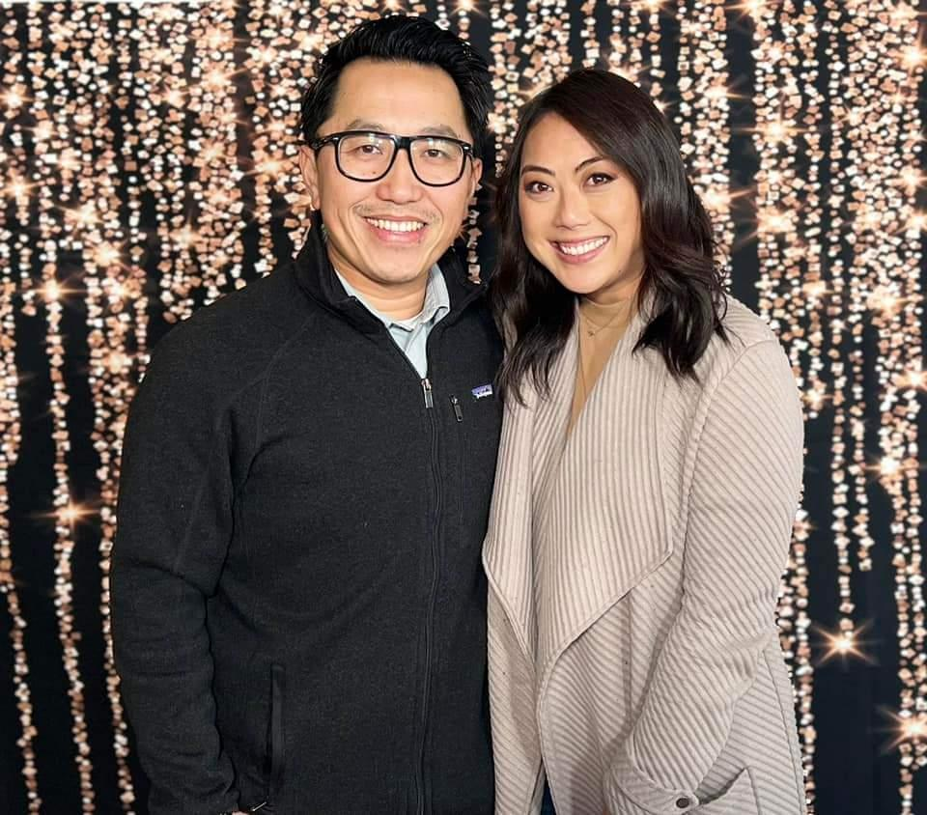
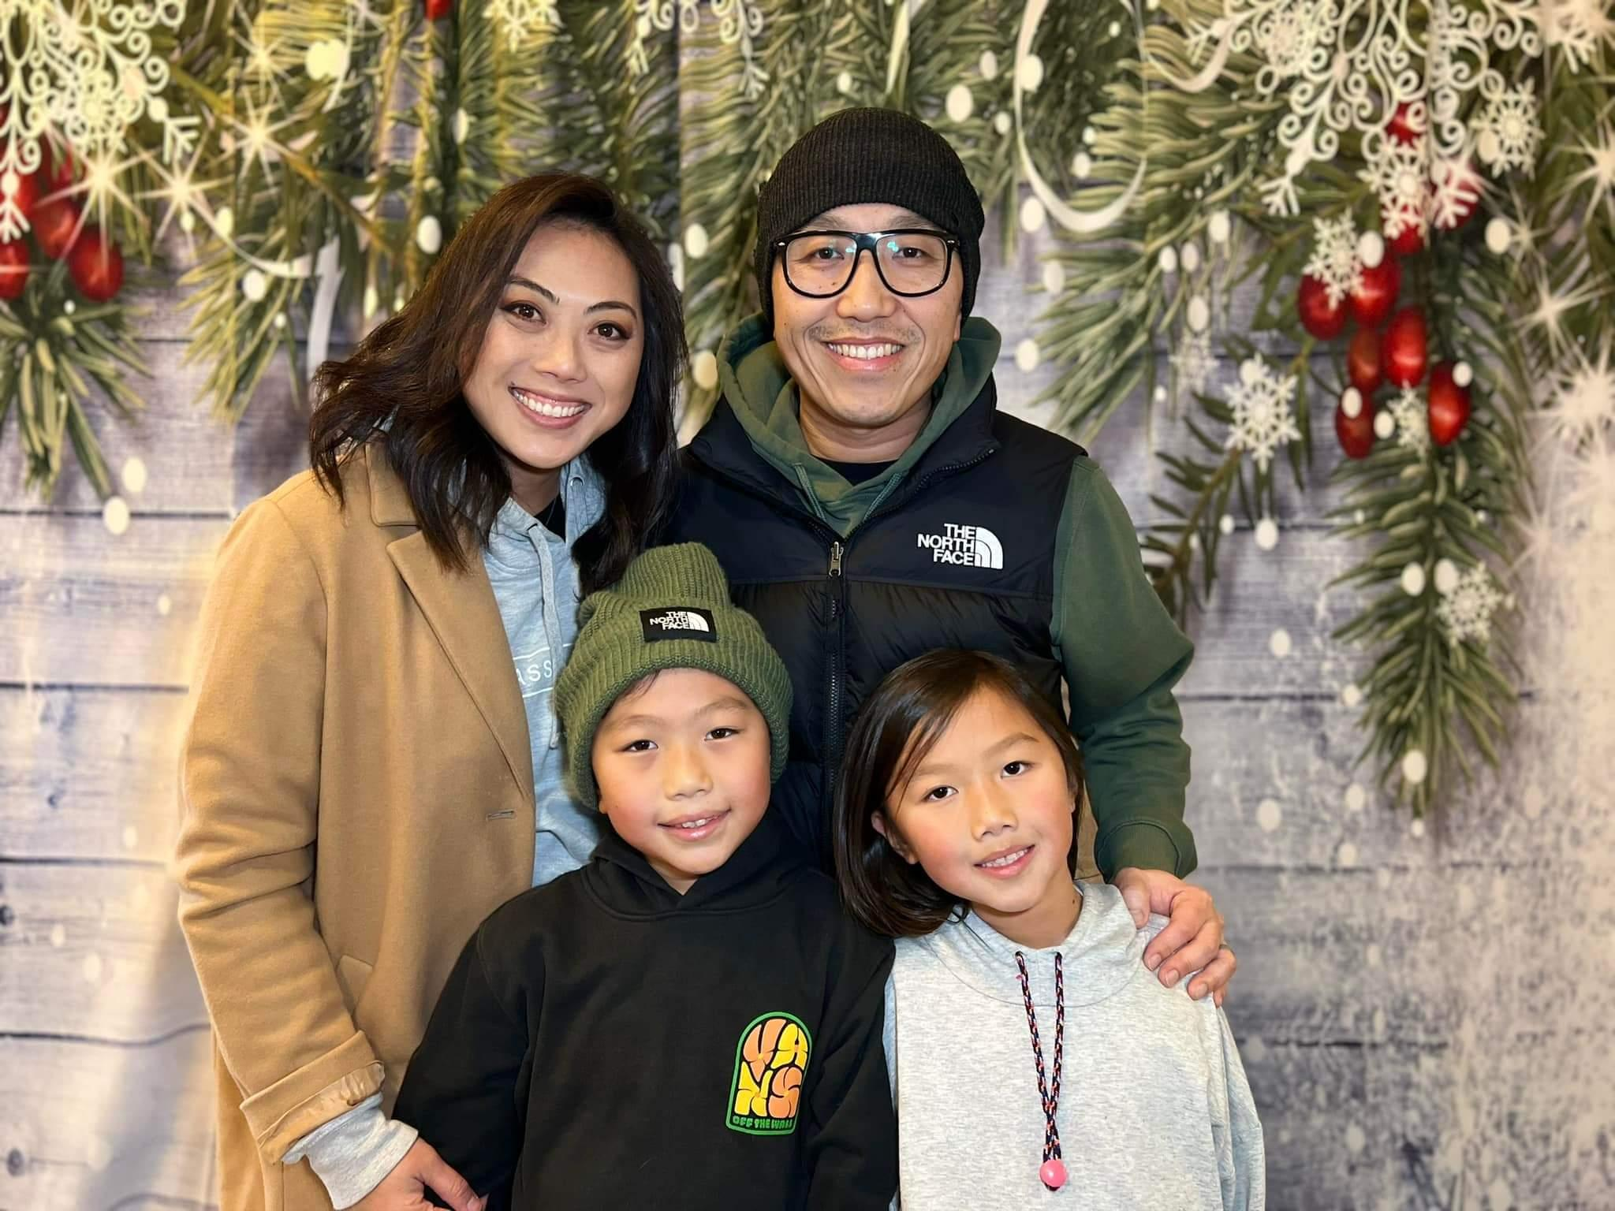
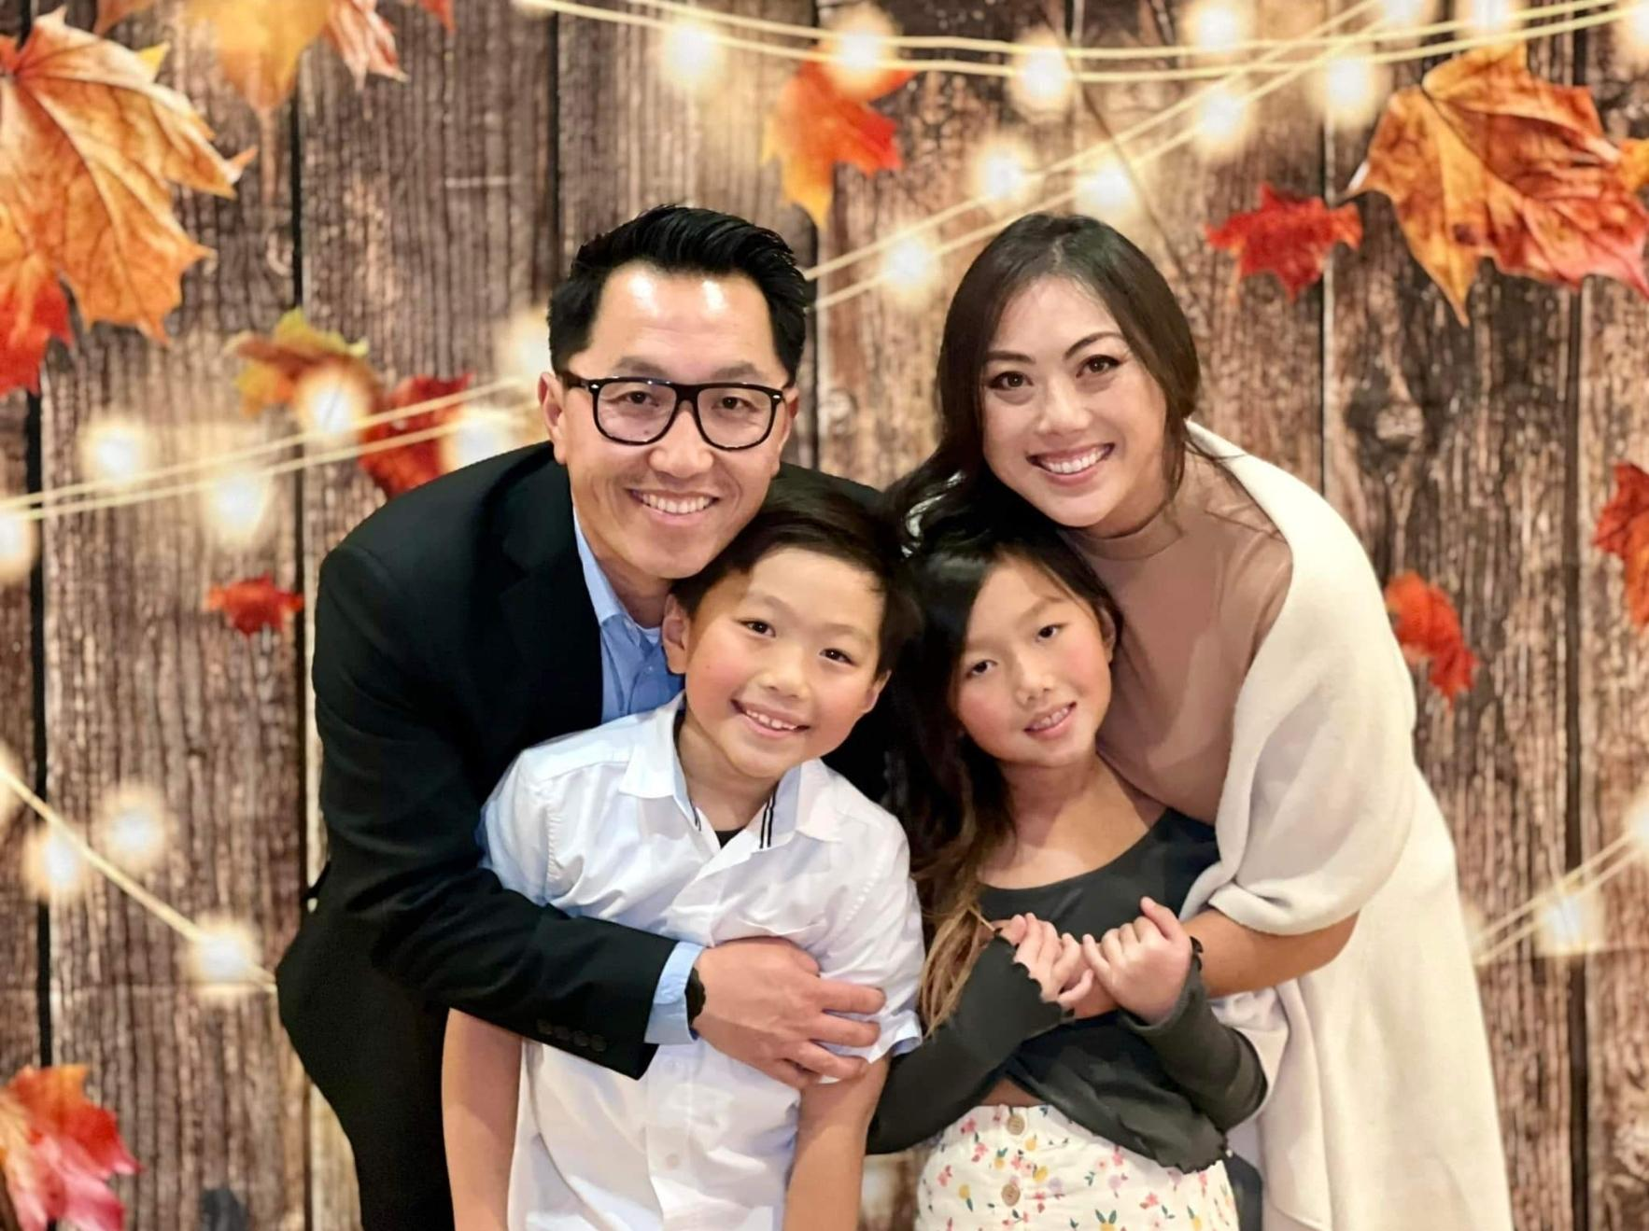

Slide 4
ASSOCIATE PASTOR FOR YOUTH/SINGLE ADULTS
Coordinators: David & May Yang
Leadership team: Skyler Vue, Landon Yang, Evelyne Xiong, & Yvonne Yang
Theme: Be Brave
Bible Passage: Joshua 3 “Crossing the Jordan”
For the year of 2022, our theme for our you was to be brave. This concept of being brave embodies the ability to continue to move forward in the face of fears and trials. When we think about our faith, we understand that it comes with a lot of challenges. To some believers, these challenges are enough to stop them in their tracks, and because of this our objective this year was to build up our young people in their faith, that even in the face of fears and trials, they would still be able to continue forward in their pursuit of the Lord.
2022 Major events: Being that Hlub camp did not fall on this year, one of our objectives was to provide a summer youth camp where the youth would be able to get away for a couple of days and grow in their relationships with the Lord as well as one another. This year’s fundraising efforts went towards making this possible.
Summary of Activities: Fundraisers: yard work and provided services to people, Youth Camp, Lock-in (early New Year’s Eve), weekly Wednesday night fellowship and end of the month fellowship.

Slide 5
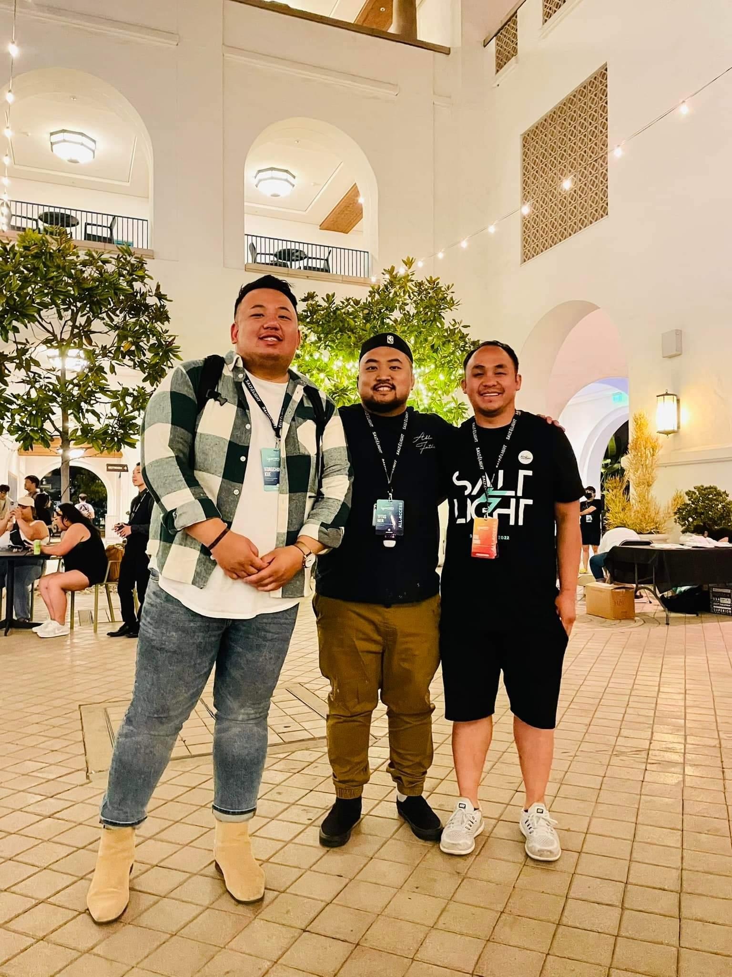
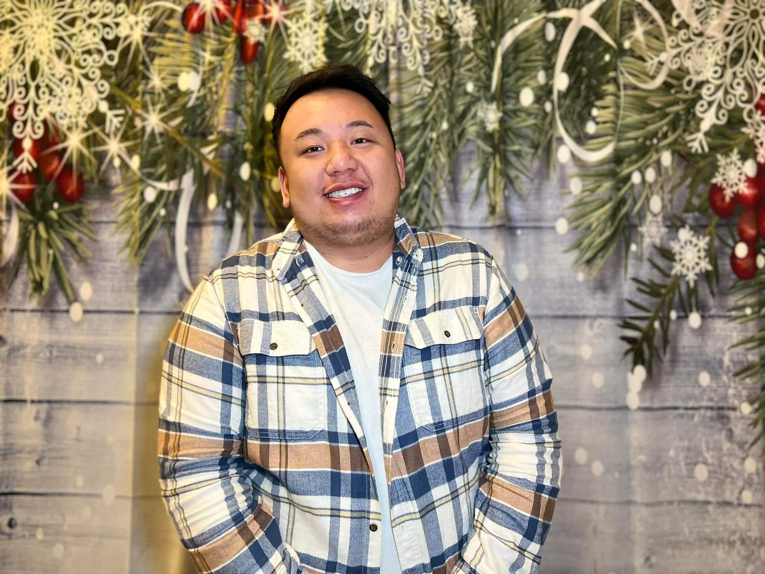

Slide 6
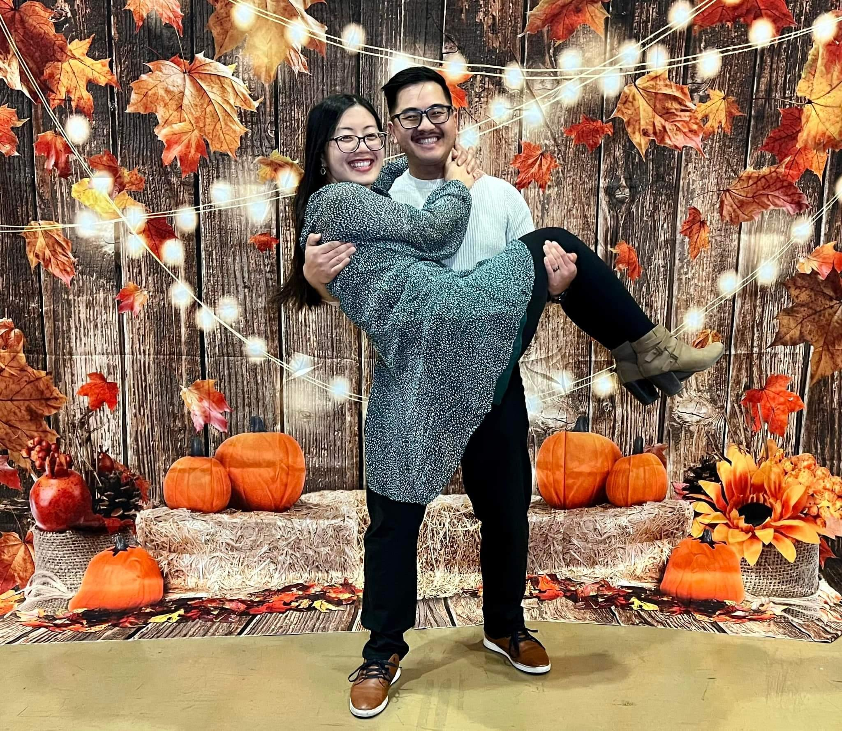
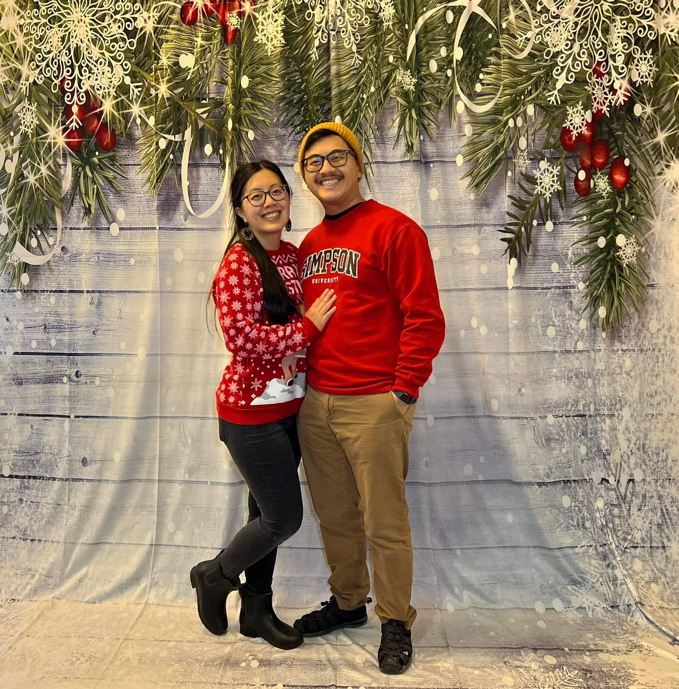
Intern Pastor

Slide 7
DISCIPLESHIP MINISTRY
Committee Members: P. Blong & Kao Zong Thao and Lee Lo & Toby Moua
Summary of Activities: CLA (18 students), Abundant Life (17 Completed, 15 in progress), FPU (6 students), Small group training (18 in attendance), Envision Short Term Mission Trip (6 attendees), Soul Care Conference (6 attendees), Weekend to Remember Conference (18 attendees), Harvest Festival

Slide 8
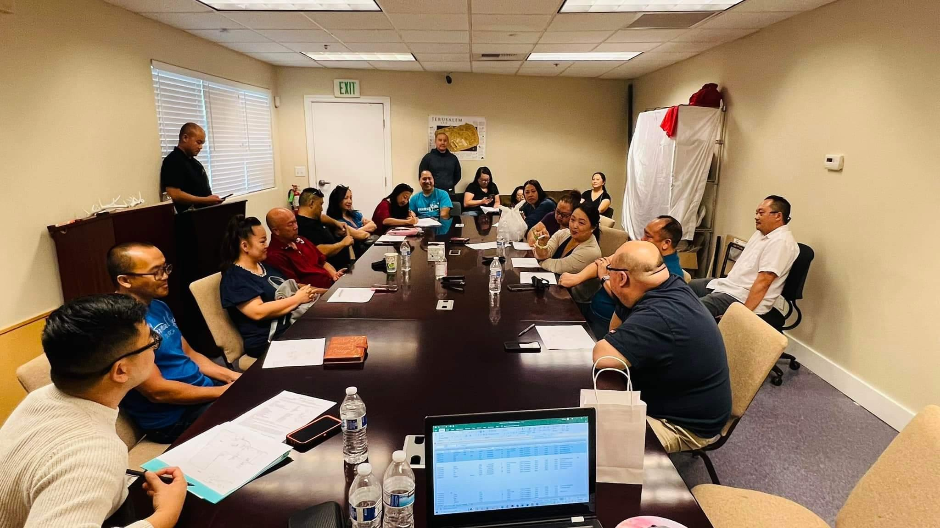
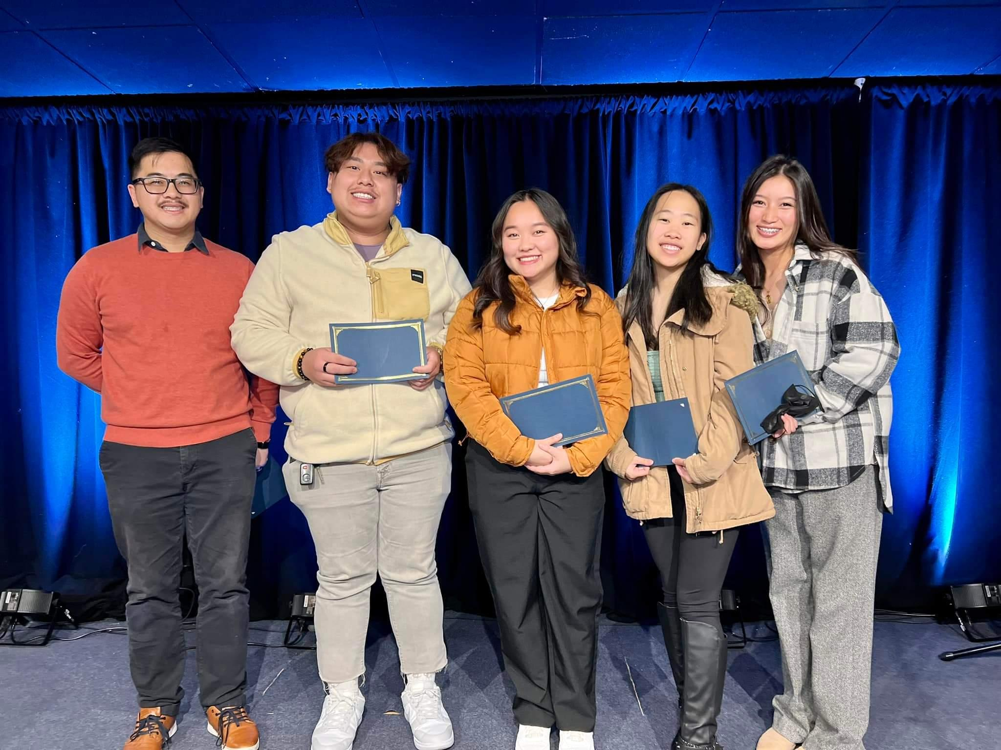
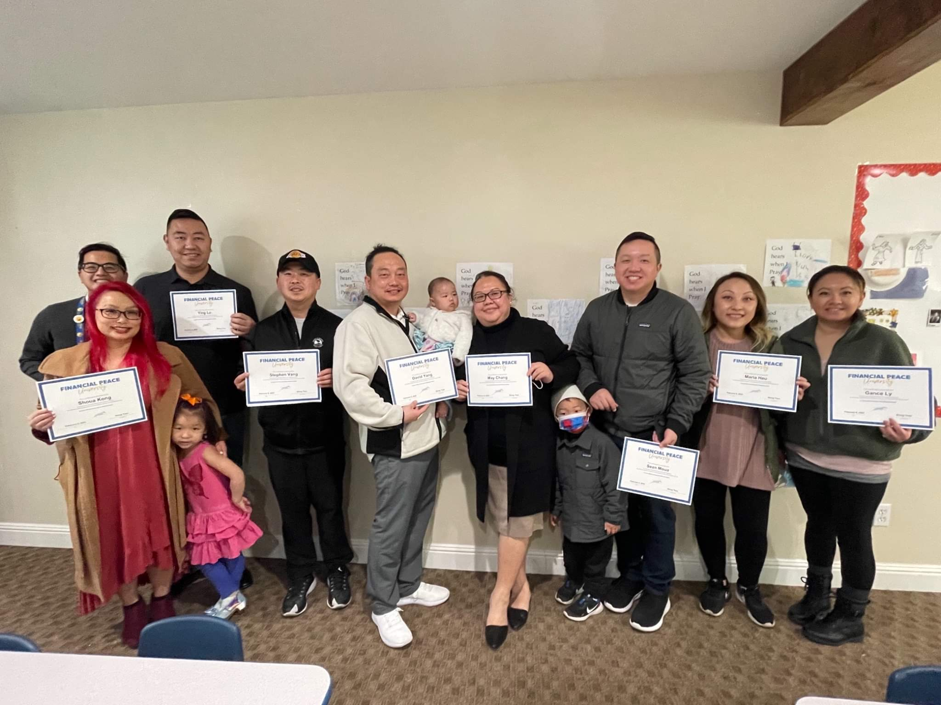

Slide 9
Missions Ministry
Committee Members: Jeff Yang, Julie Xiong, Tony and May Yang, Stephen Vang, Gance Ly, Maria Heu, Blong and Kao Zong Thao
Vision Of Ministry: To provide information to our members on God's greatest commission to us in sharing the gospel. As a CMA church, we strive to understand ministries overseas and locally so we are aware of the resources needed for the Great Commission. In order to do this, we bring missionaries to share their experiences.
We are working towards doing more outreach locally to share the gospel and find the needs of our own community.
Theme: Be Present
Summary of Activities: Thanksgiving Turkey and Rummage giveaway, Mini Mission’s Conference with Brett Bower (France), Easter/Passover Sedar with Caplain Jacob Cohen, Mission Conference with Aaron and Rhonda Steiner (Berlin, Germany)
Overall areas of success: This year we were able to have three conferences (one local and two with ministries overseas). Most years, ELC has only done one Mission’s Conference. Although not part of this team, six ELC members were also able to share overseas ministries that traveled to Bangkok, Thailand to learn about the culture and ministries with Envision Bangkok. We held a service in Hmong and English Service to share what we learned.

Slide 10
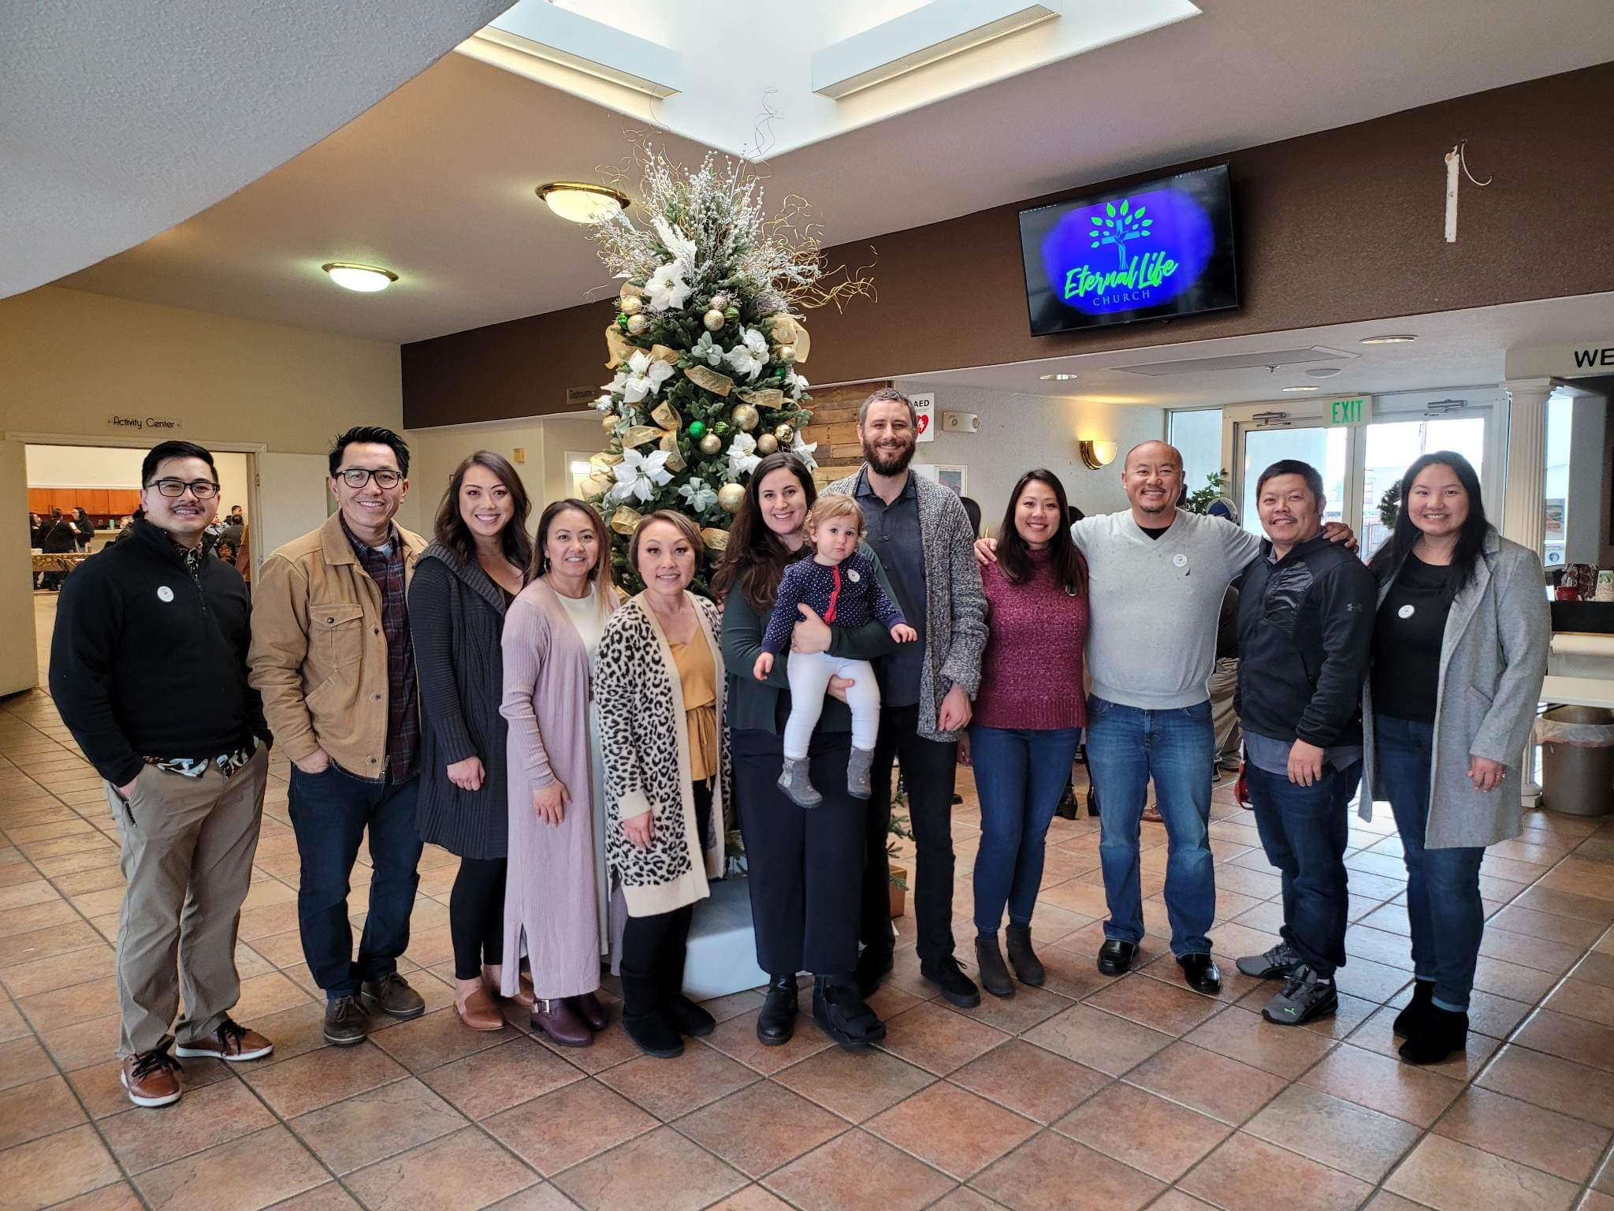
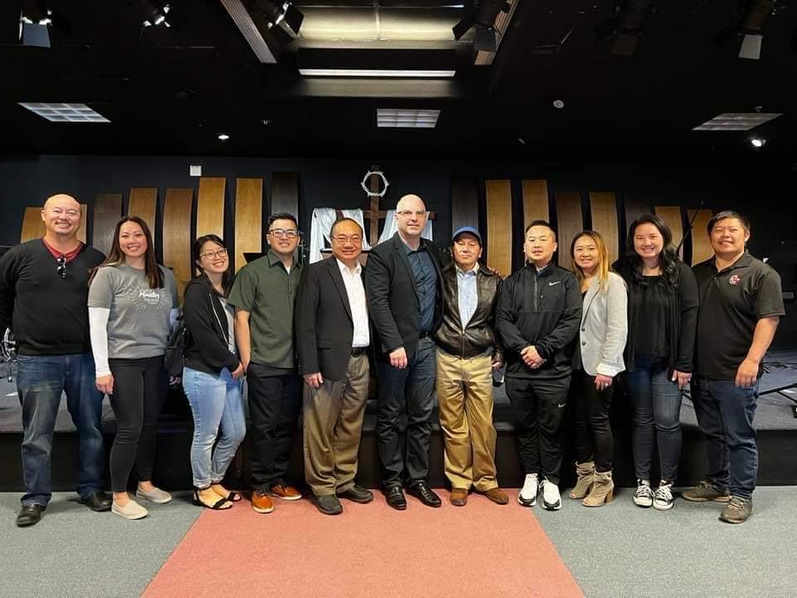
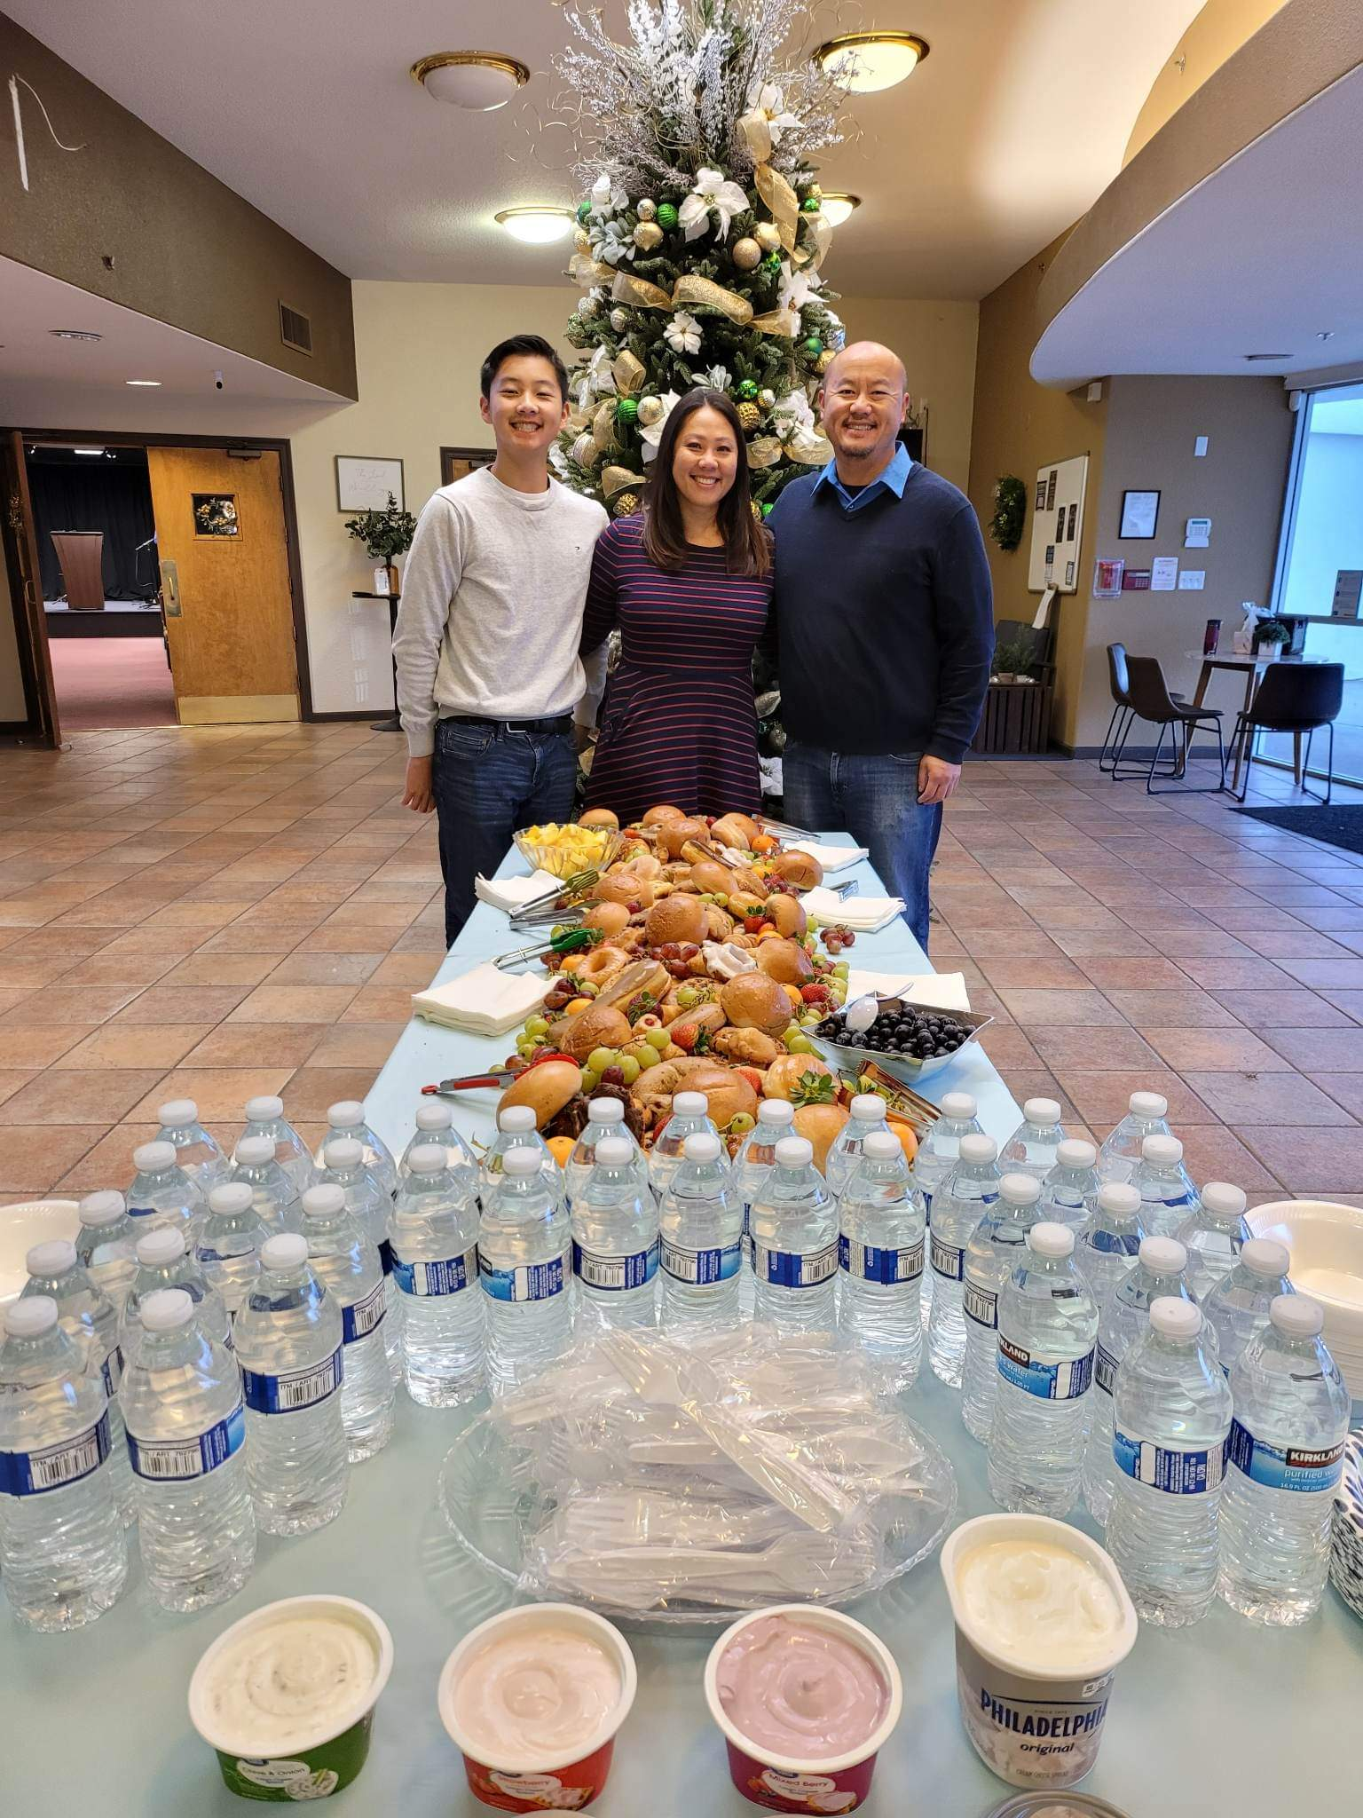
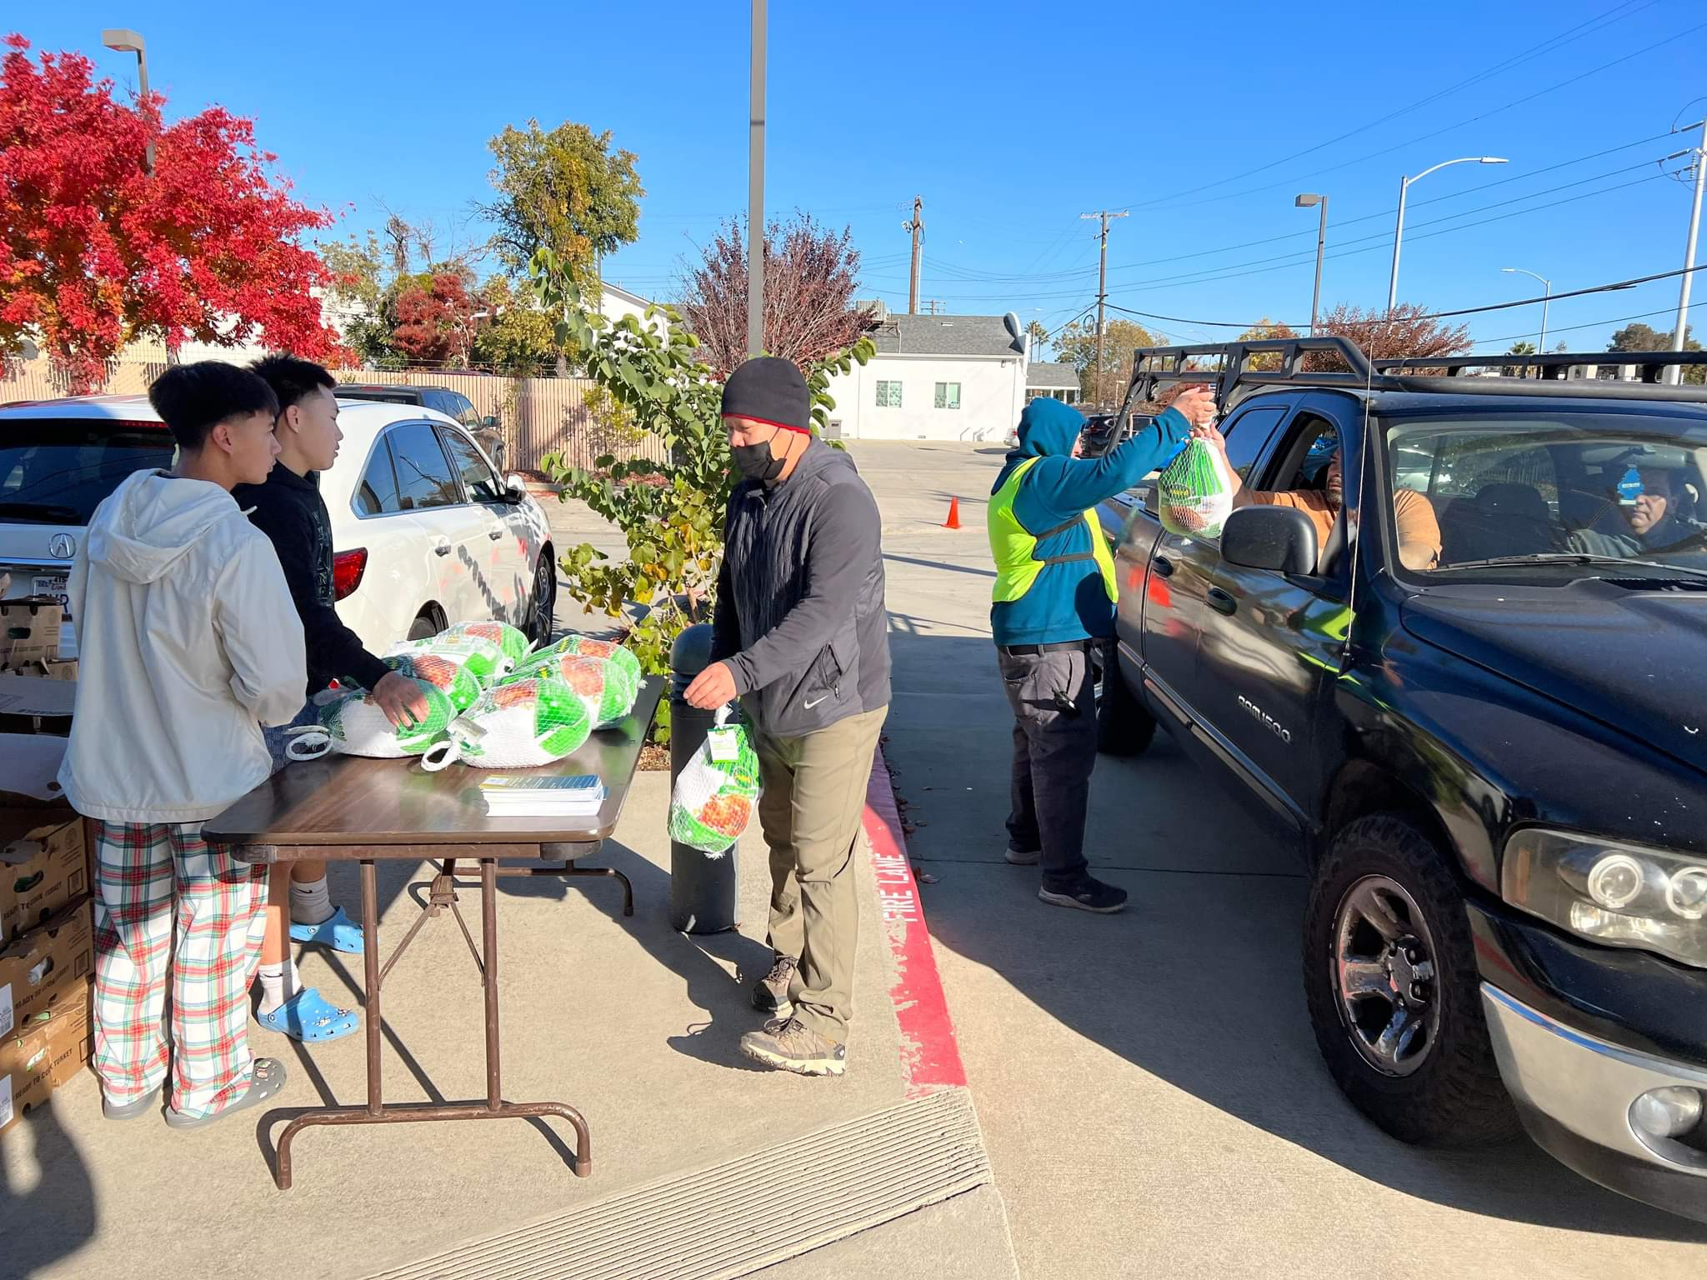
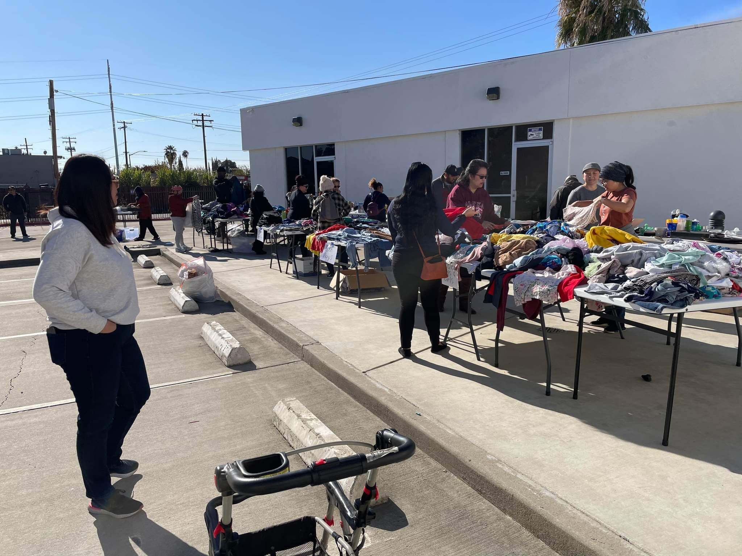

Slide 11
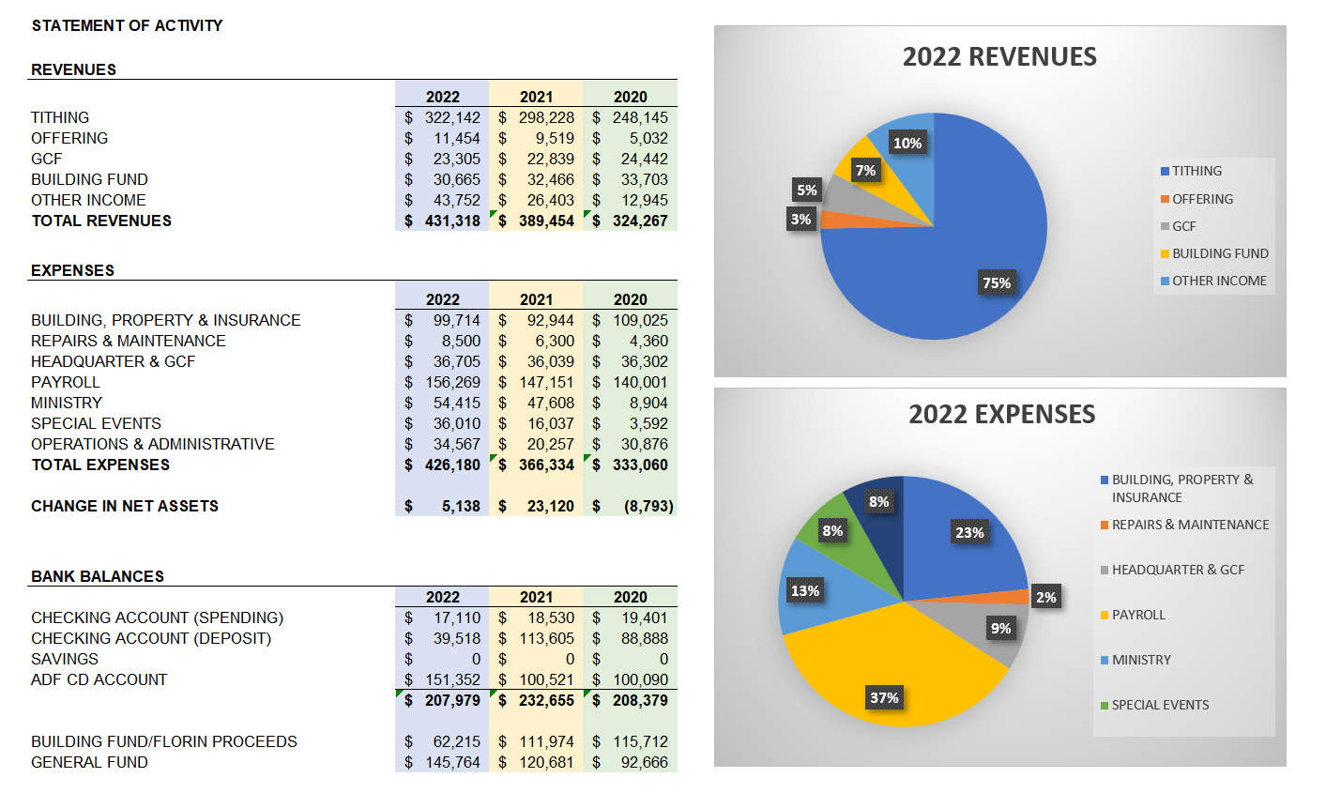
FINANCIALS

Slide 12
FINANCIAL AUDITS
JANUARY-JUNE 2021 /JULY-DECEMBER 2021
January-June 2022 Conclusion
All financial records provided agree with the bank statements for the period under audit. The examined financial records from January 1, 2022 through June 30, 2022 are fairly stated.
July-December 2022 Conclusion

Slide 13
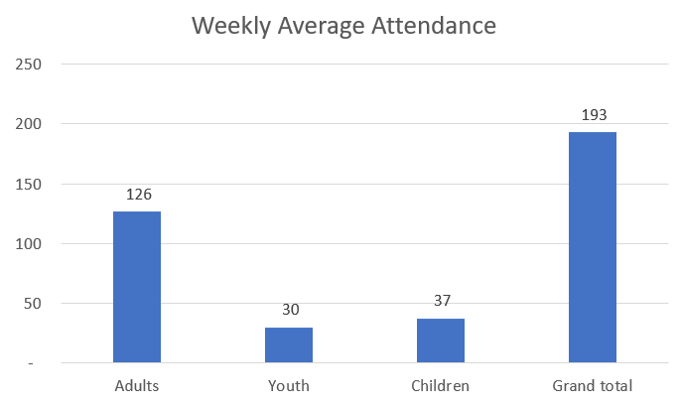
2022 MEMBERSHIP ACTIVITY

Slide 14
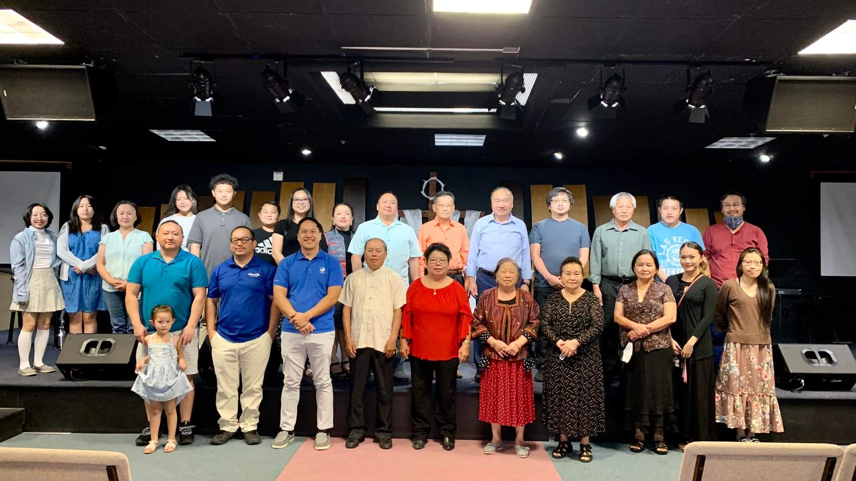
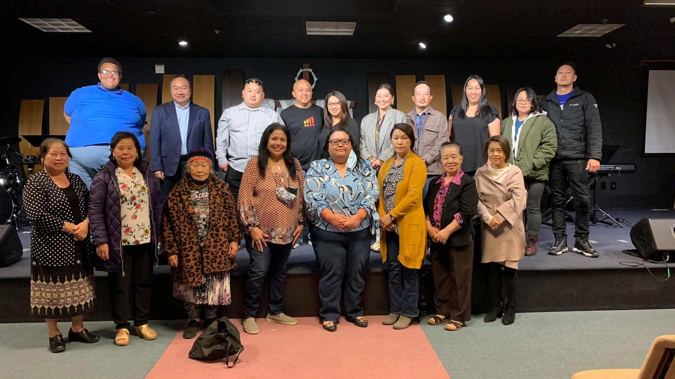
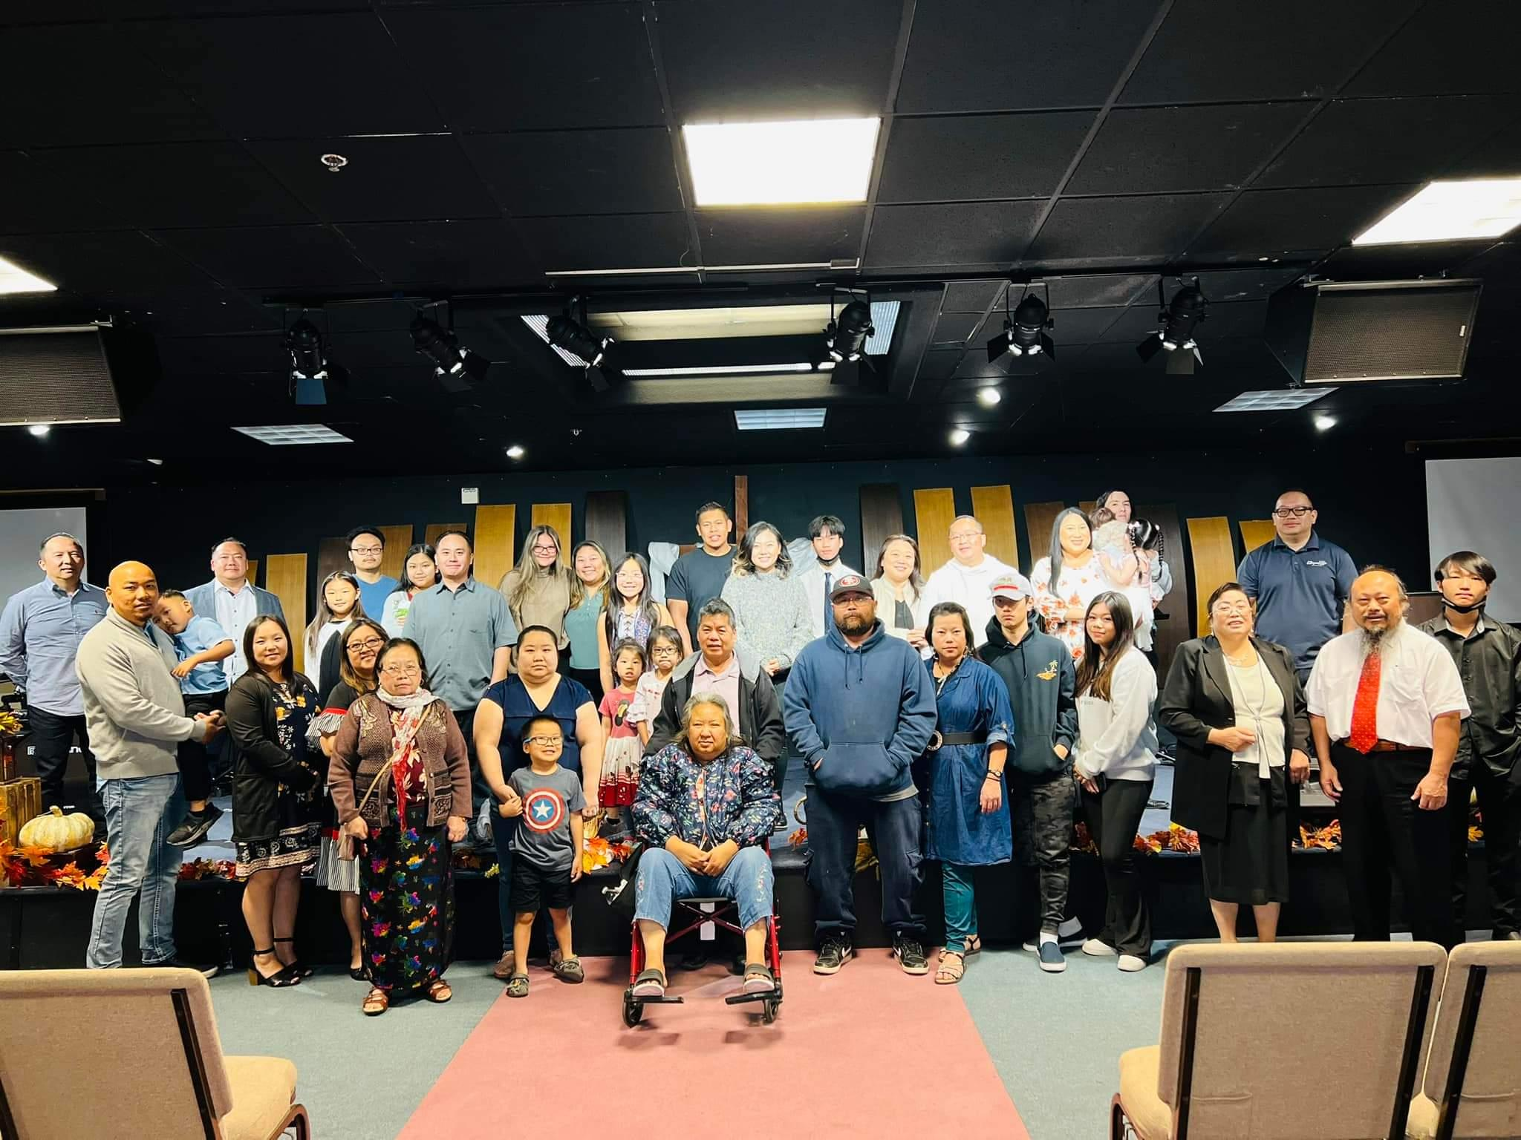
New Member Orientation:
New members: 51

Slide 15
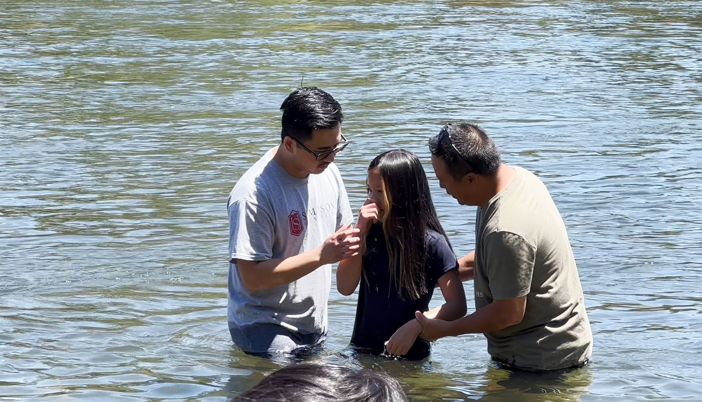
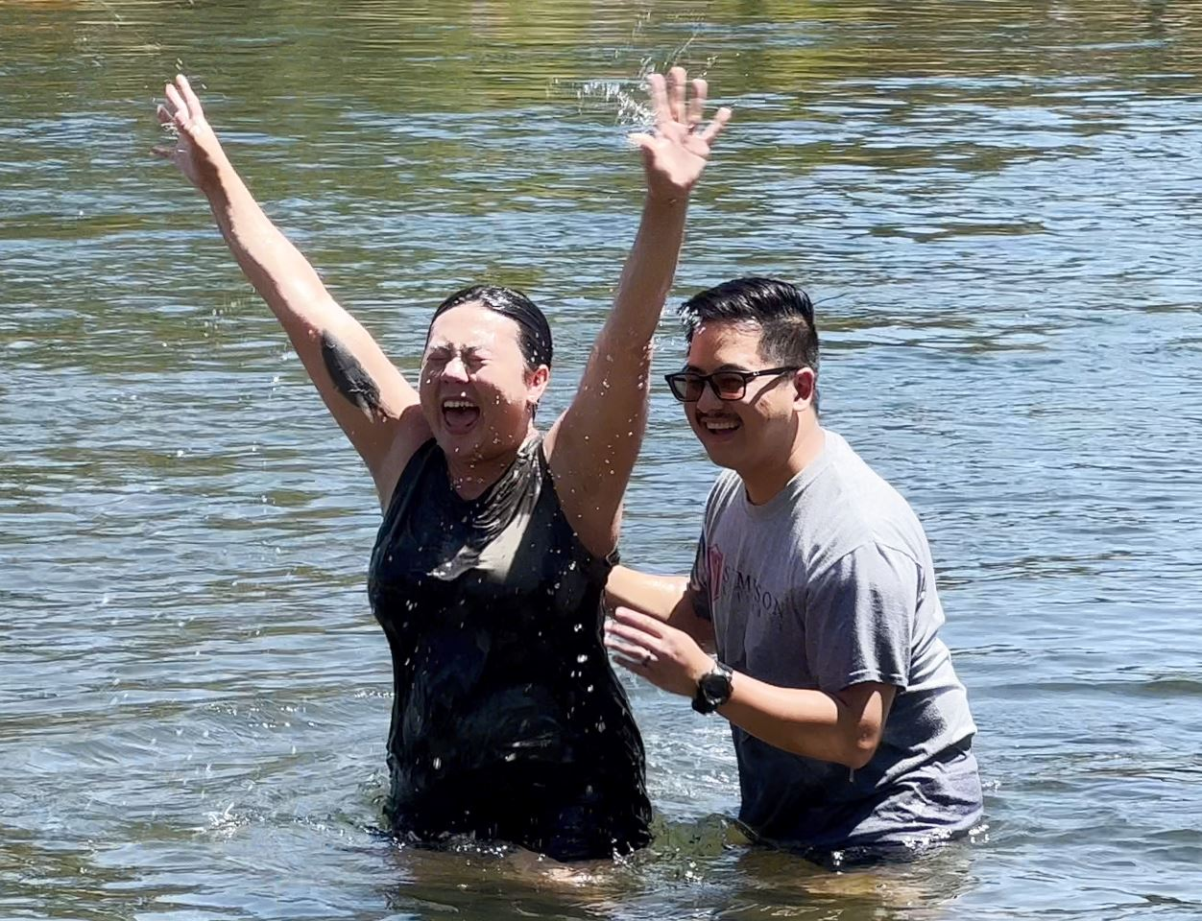
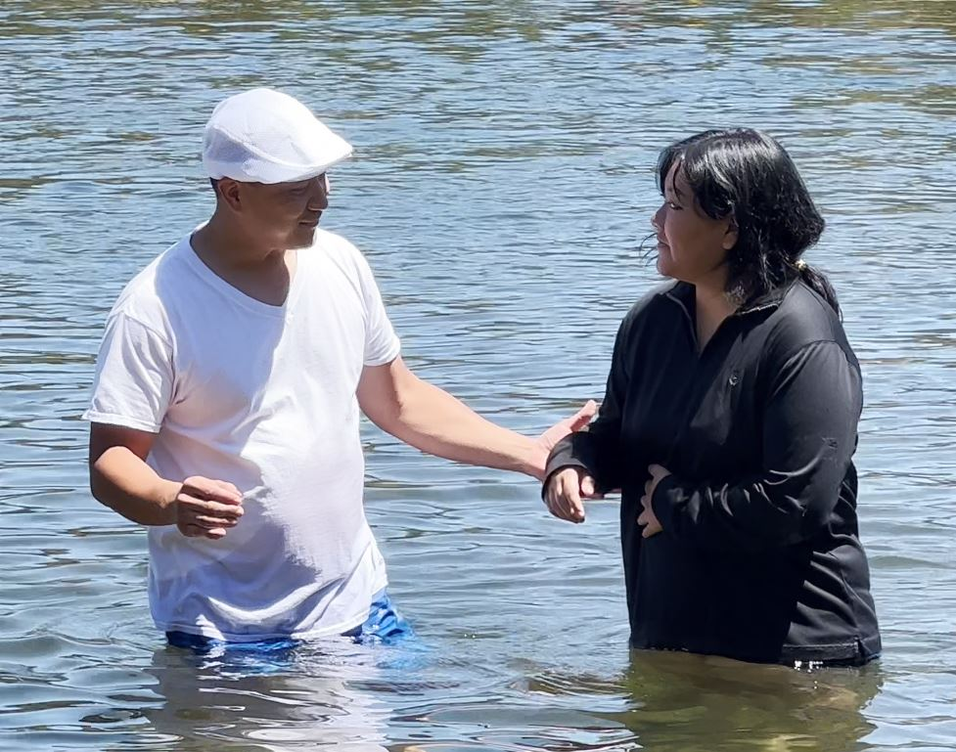
BAPTISM
PROFESSIONS OF FAITH = BAPTISM= 9

Slide 16
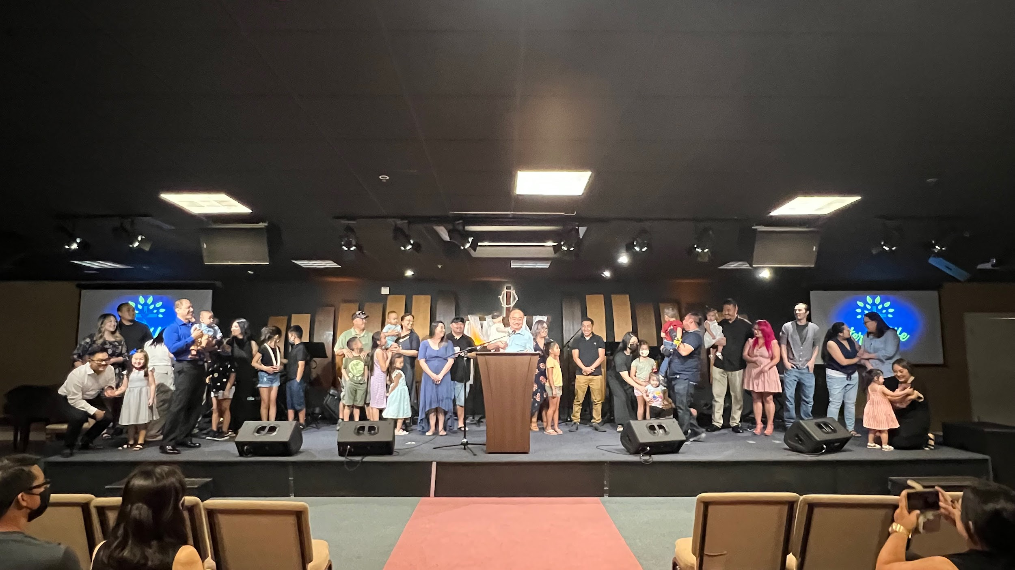
BABY DEDICATION = 21

Slide 17
HMONG MINISTRY
Coordinators: Lue, Ya Youa, Tony, Trou, Cheng, Chao, Thomas, May Xia
Summary of Activities: Hosted ELC Christmas Dinner, 3 fellowship events, Food pantry, Summer Camping Trip, Care packages for members in Hmong ministry.

Slide 18

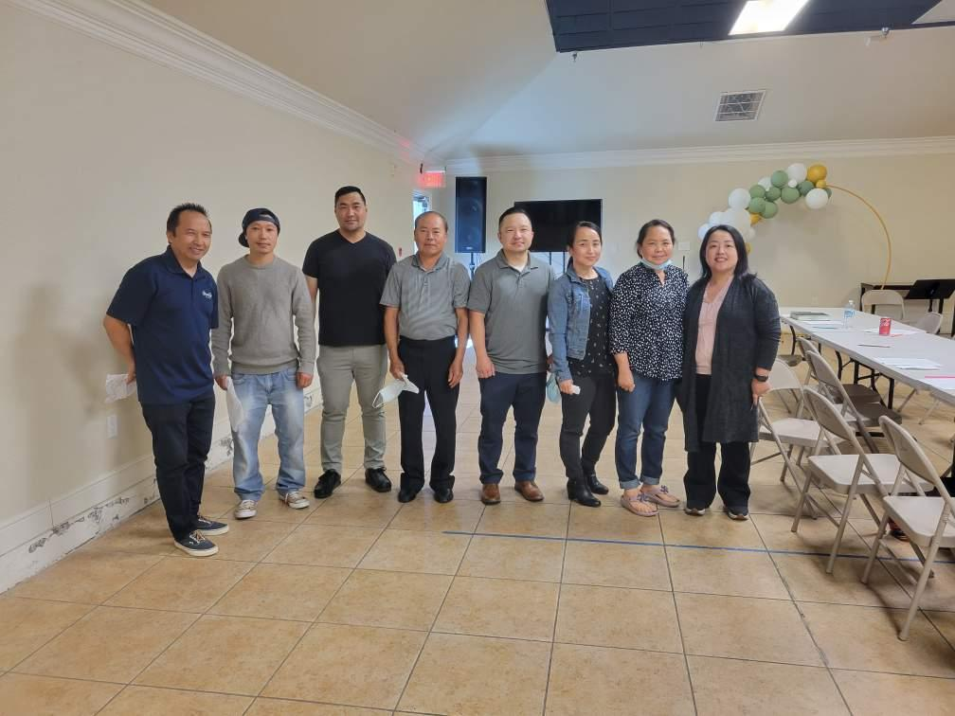

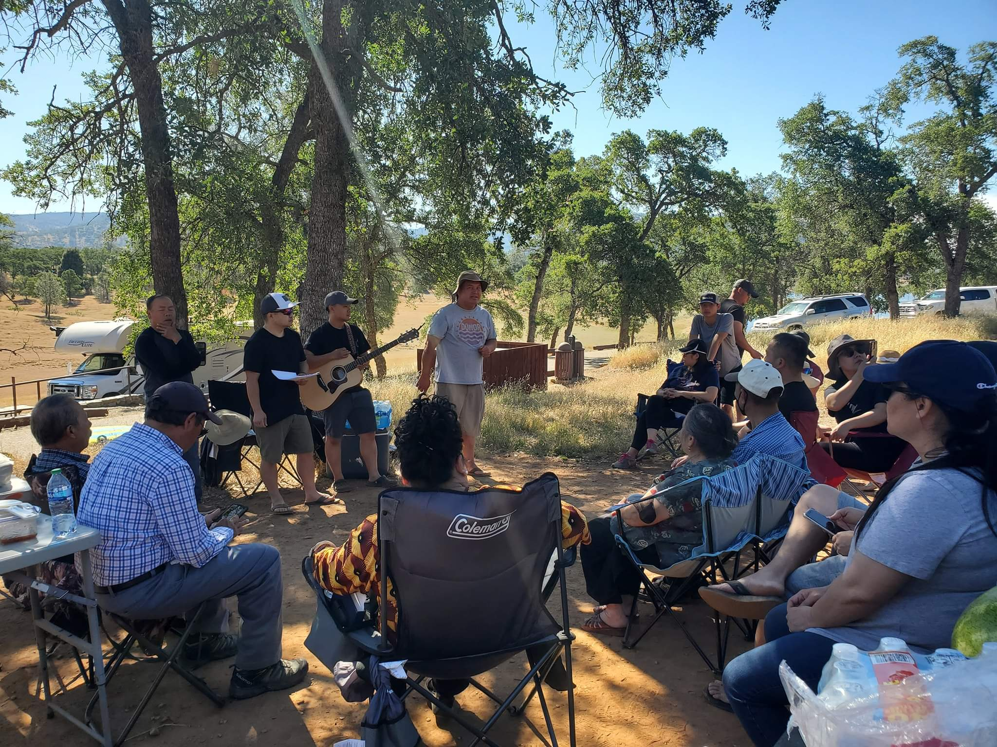

Slide 19
Men’s Ministry
Committee Members:
Alex Vang, Nou Vang, Hang Xiong, and Ger Vang
Vision Of Ministry:
Working as the body of Christ to faithfully serve and build up our fellow brothers and neighbors at ELC by reciprocating the love He has given us and sharpening each other through scripture, testimonies, and devotions as we’ve gathered for our events throughout the year.
Theme:
Be Christ Like – Inspire, encourage, and support ELC men and neighbors for spiritual growth and help each other to understand what it means to be more Christ like, as He sacrificially served us all with mercy, grace, and love.
Summary of Activities:
Breakfast Fellowship, Men’s Night Fellowhip, Men, Women, and Youth Recreation Day, Men’s Zipline at Quarry Park Adventure, Men’s Ministry Summer BBQ, Men’s Camp Alta Retreat, Men’s Christmas Dinner, ELC Highway cleanup Project.
Overall areas of success:
● Overwhelming support from other Ministry teams and accomplished most of our desired goals as a team.

Slide 20
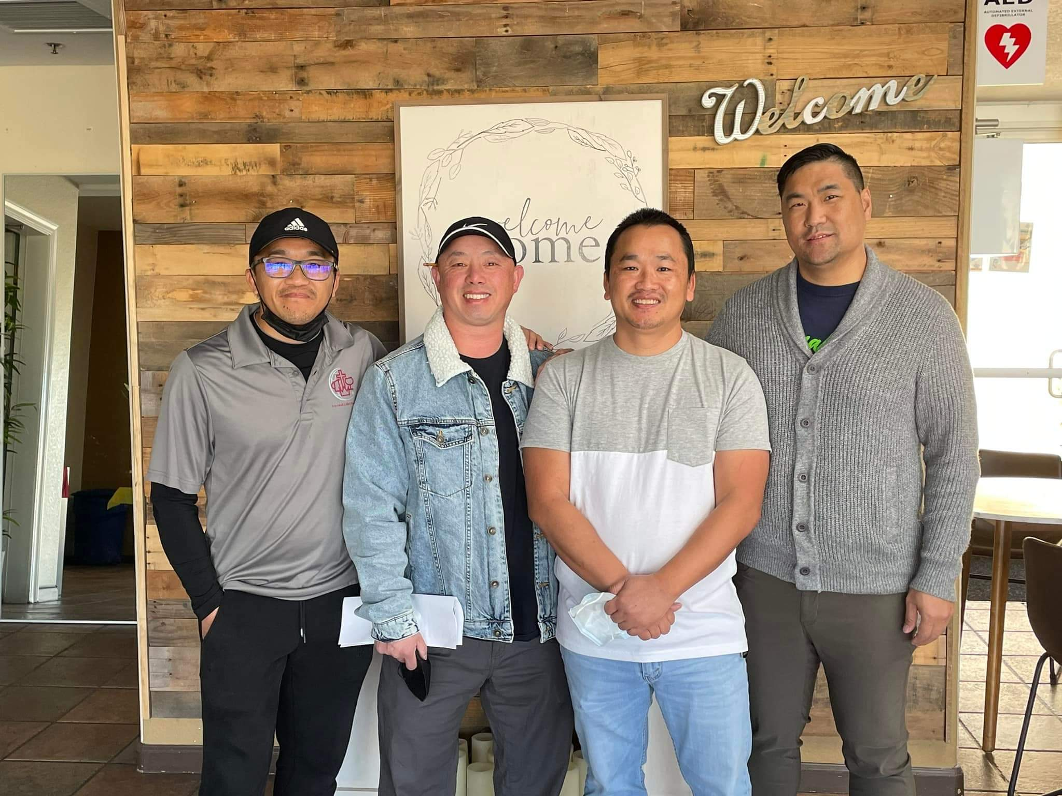
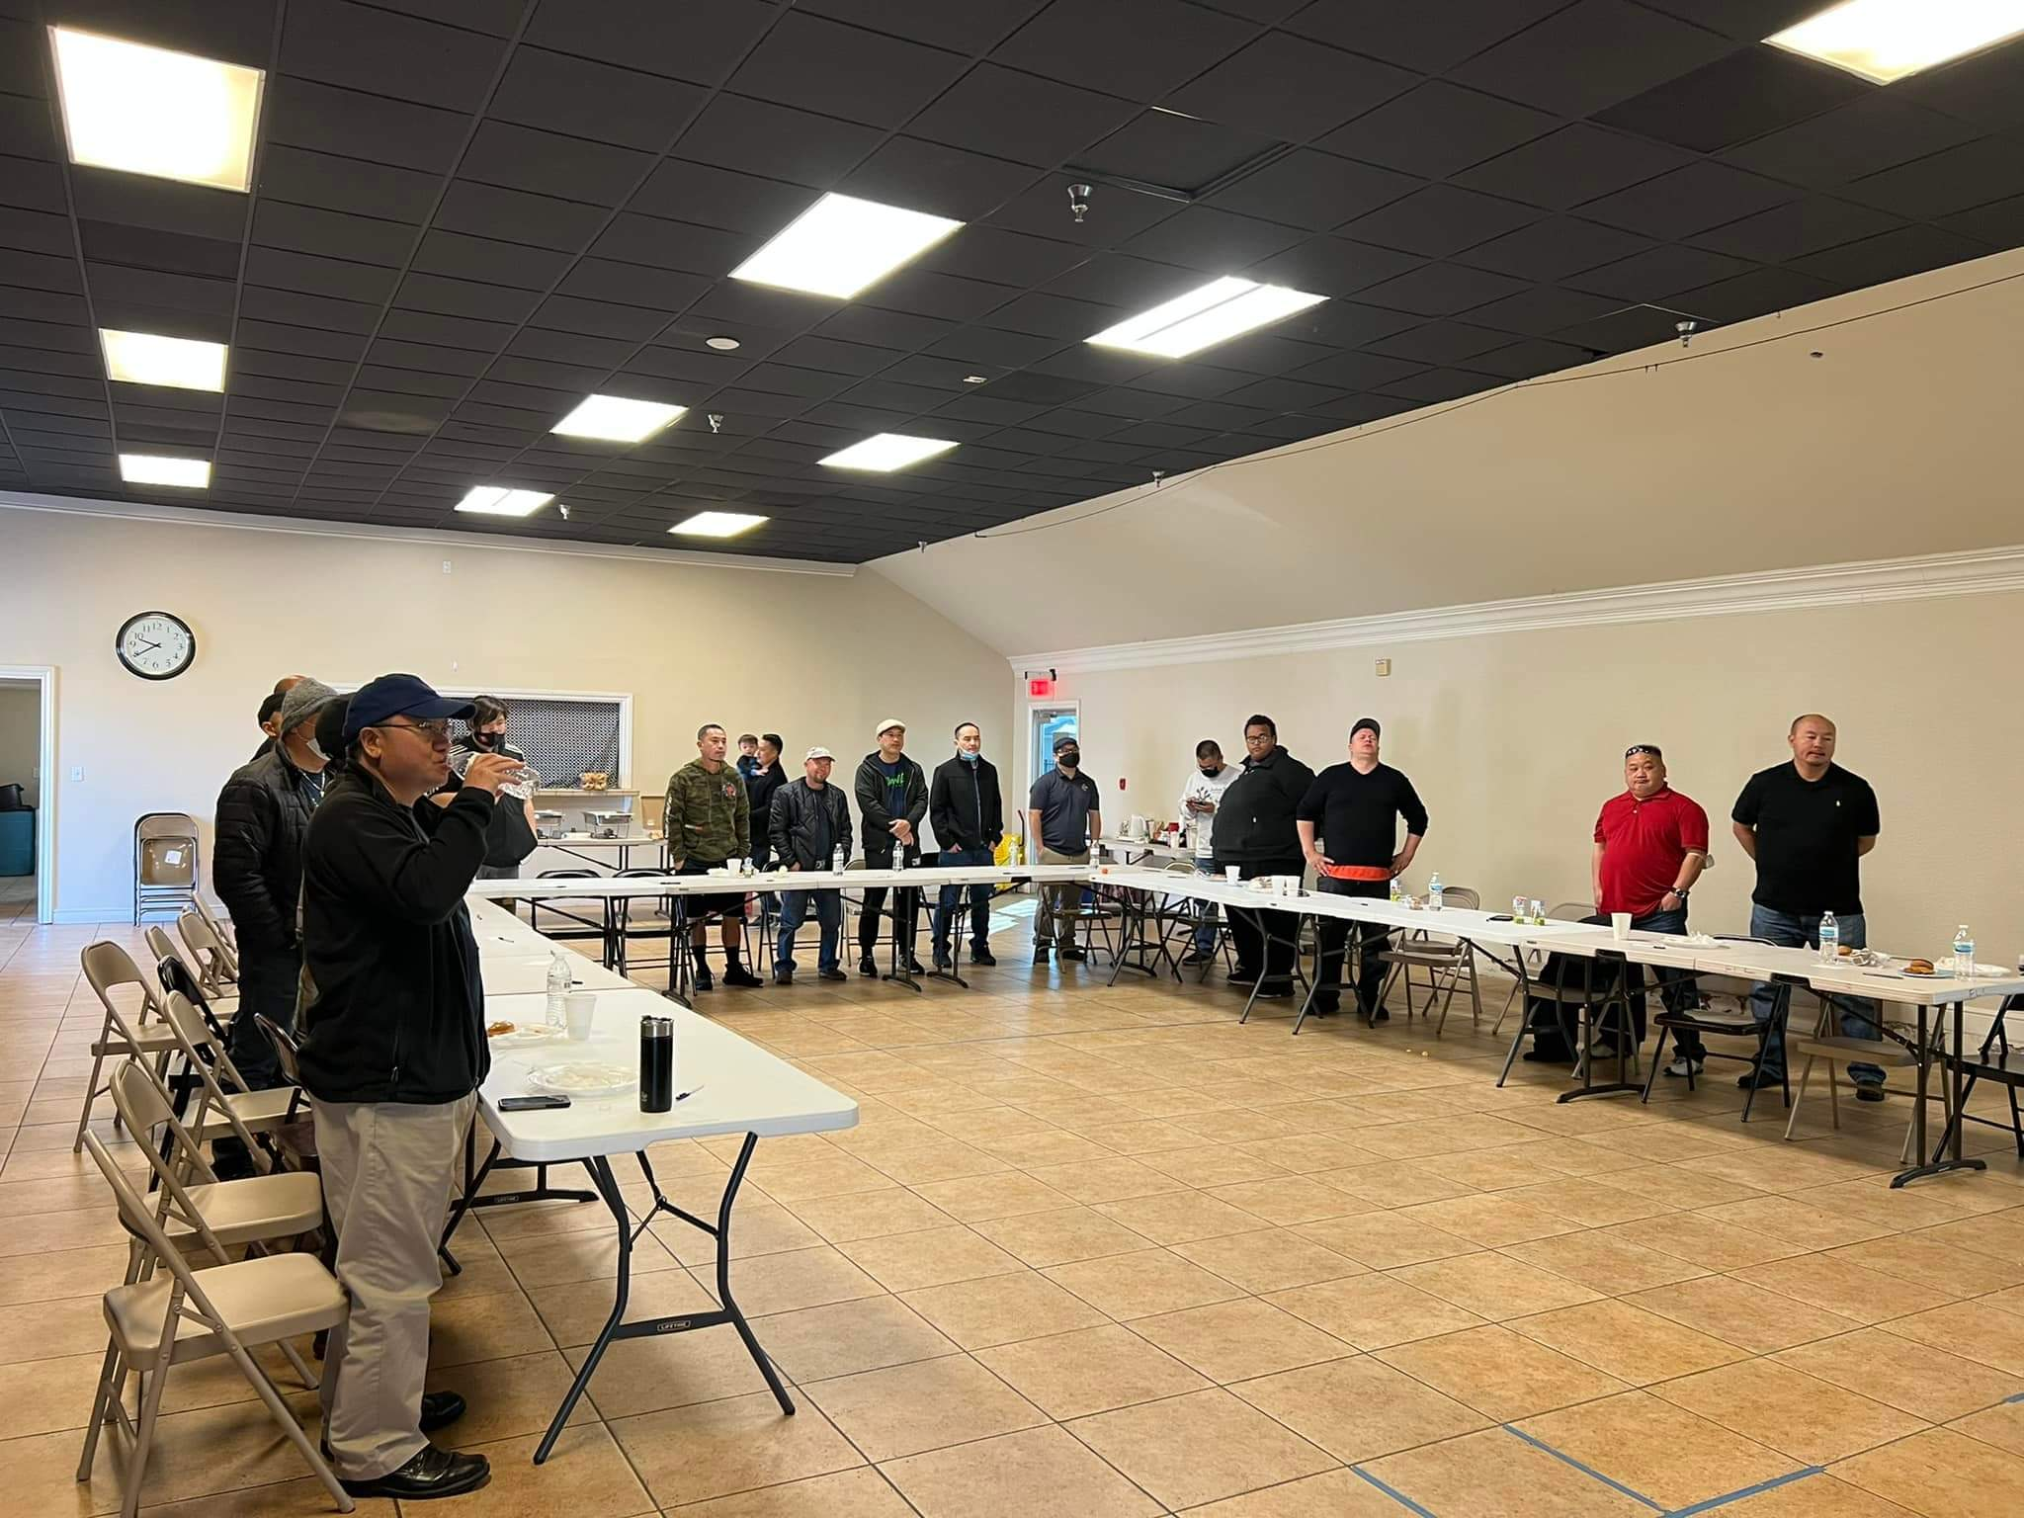
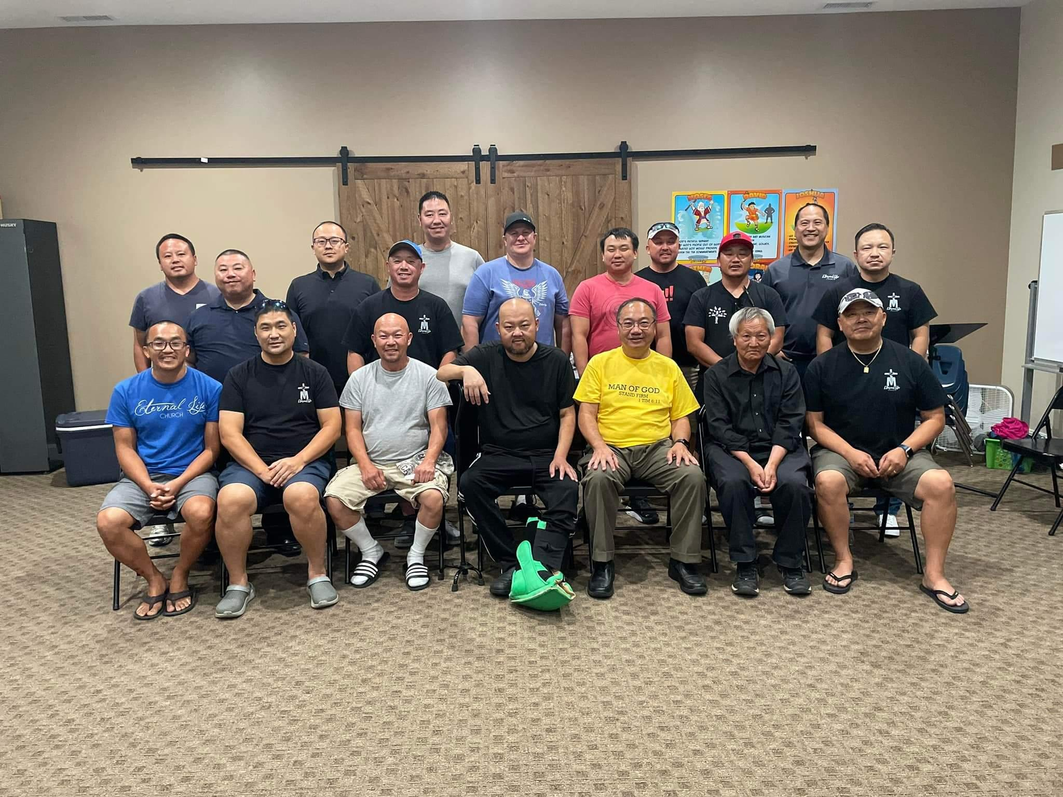
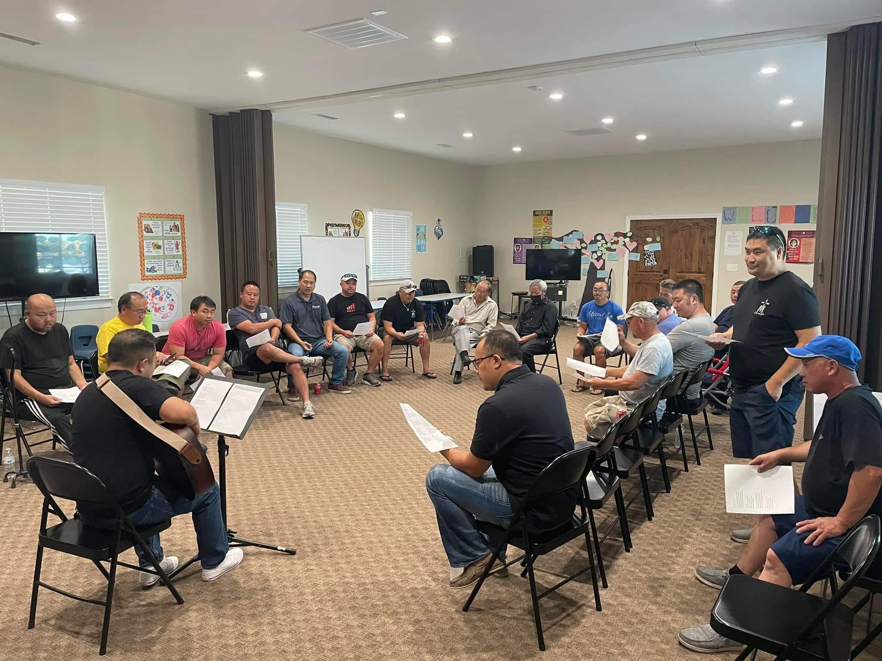

Slide 21
WOMEN’S MINISTRY - GGS
Coordinators: May Lee-Yang, Alex Lee-Xiong, Serena Xiong, Xeng Her
Vision Statement : To Reach Up, Reach Out, and Reach In and Lead People to Experience a God-First Life.
Mission Statement : Women’s Ministries (GGs) exist to inspire, equip, support, and disciple women to live in God’s purpose. We will fulfill our vision by creating opportunities and resources for women to discover their gifts and be empowered to fulfill His purpose. Our desire is to encourage every woman in her journey, and to provide meaningful opportunities for discipleship. We will connect women to Jesus. We will create community. We will cultivate discipleship.
Theme: H.O.P.E. - Holding Onto God’s Promises Each day
Summary of Activities: GG’s Tea and fellowship, Breakfast Fellowship, Men’s, Youth and GG’s Recreation Day, Attended “Let Go and Let God” SHAC women’s conference, Paint and Fellowship Night, Mosaic Evening, Collected Love offerings for our 2 of Sister’s loss of loved ones, Prayer night for Lee at her house, Ladies Retreat, Amen Ramen Night, GG’s Christmas dinner, a meet and greet with NZF Christian. Host the Thanksgiving Banquet, held 3 fundraisers and hosted 2 book studies that lasted 10-15 sessions.
Overall areas of success: TheWomen Retreat was a huge success with 73 attendees. This year’s attendees included young adults, women from the Hmong Ministries within ELC, outside members external to ELC, non-believers (39%). The Book study was also a success as they were able to reach ladies who were not local or hesitant about attending sunday service. ELC Thanksgiving Banquet had about 480 attendees, most importantly outreach to friends and family members that are non-believers to invite them to come and have Thanksgiving with their ELC family.

Slide 22
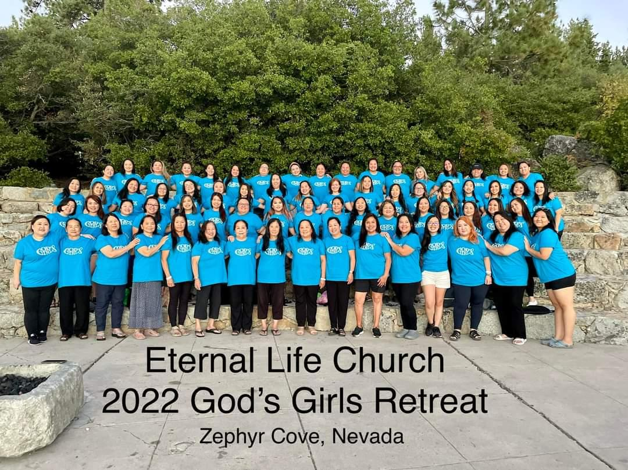
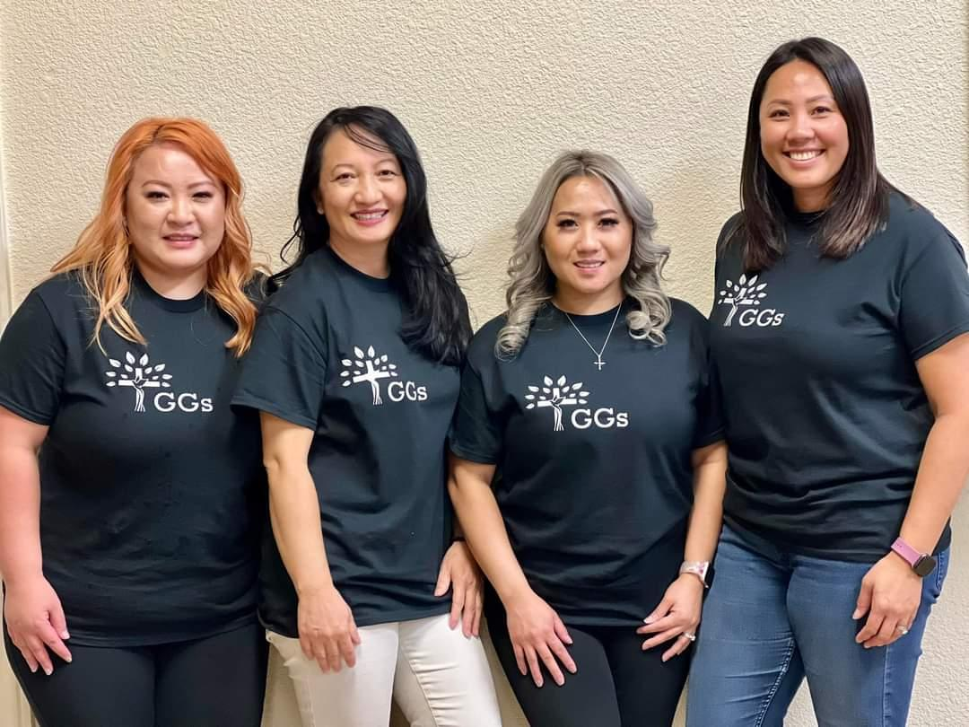
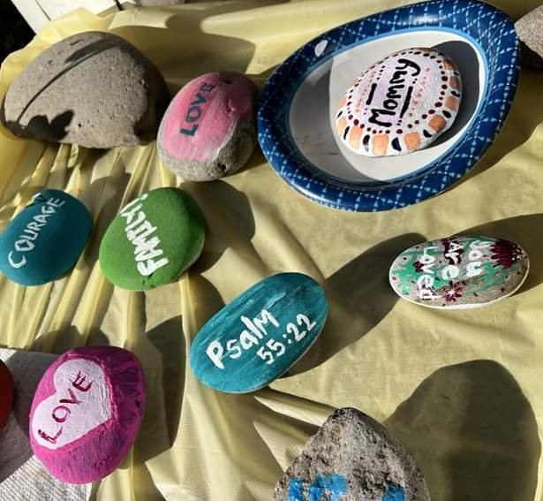
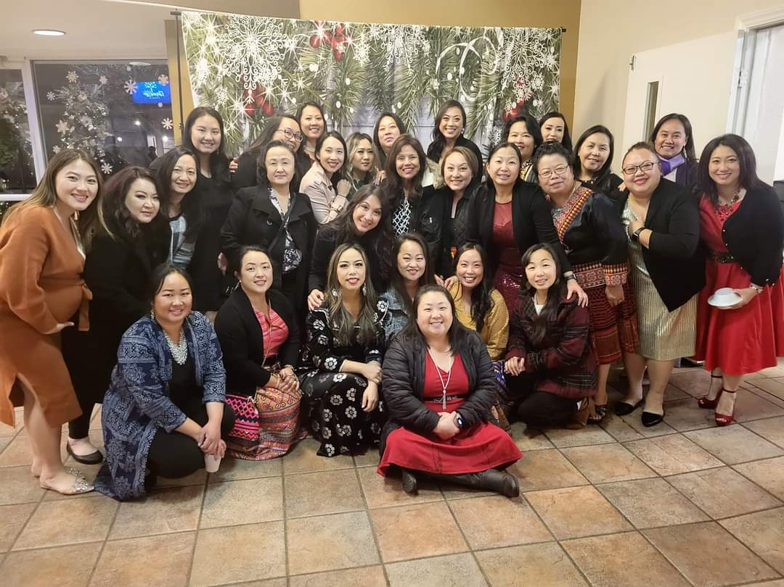
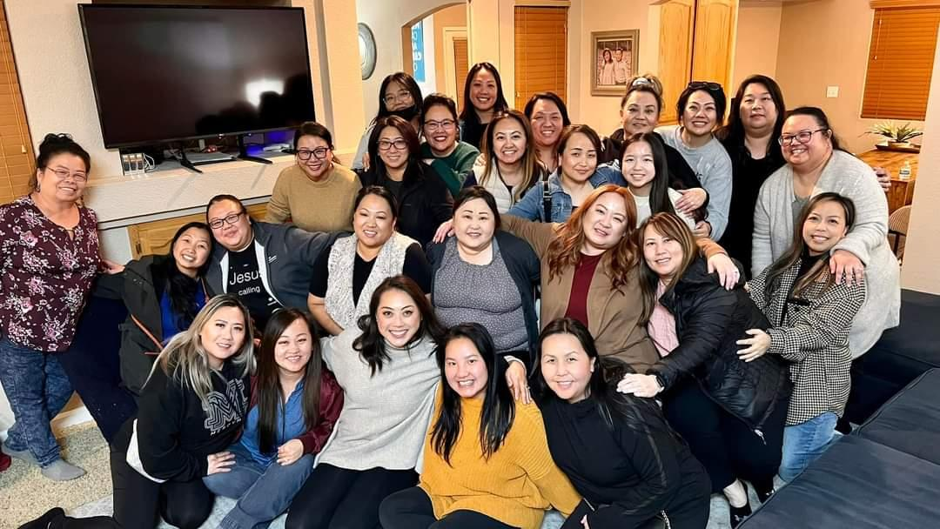

Slide 23
CHILDREN’S MINISTRY
Committee Members:
Zoua Vang, Jennifer Heu, Ya Youa Xiong, May Cha, Lien Nguyen, Pang Xiong
Vision Of Ministry:
The purpose of ELC’s Children’s Ministry is to faithfully teach scripture and demonstrate the love of Christ to all children so that they will become disciples of Christ who trust, serve, worship, and obey Him now and into eternity.
Theme:
Encourage and empower children and their families to know Jesus and share His story. Support the development of a strong biblical foundation using Epic Teachings of the Bible curriculum.
Summary of Activities: Teacher training/orientation, Classroom decorating contest/Fellowship with coordinators and teachers, participated with Easter service: skit, song and Easter program for the kids, provided a children’s program during Pastor Daniel’s farewell party and again during Pastor Christopher’s Farewell party, adopted and implemented new curriculum for Sunday school, held a transition ceremony, provided a children’s program for the Annual Picnic, VBS, children’s program for Thanksgiving banquet and Christmas dinner.
Overall areas of success: Events and activities were all successfully executed. The team had good communication with one another and the teachers.

Slide 24
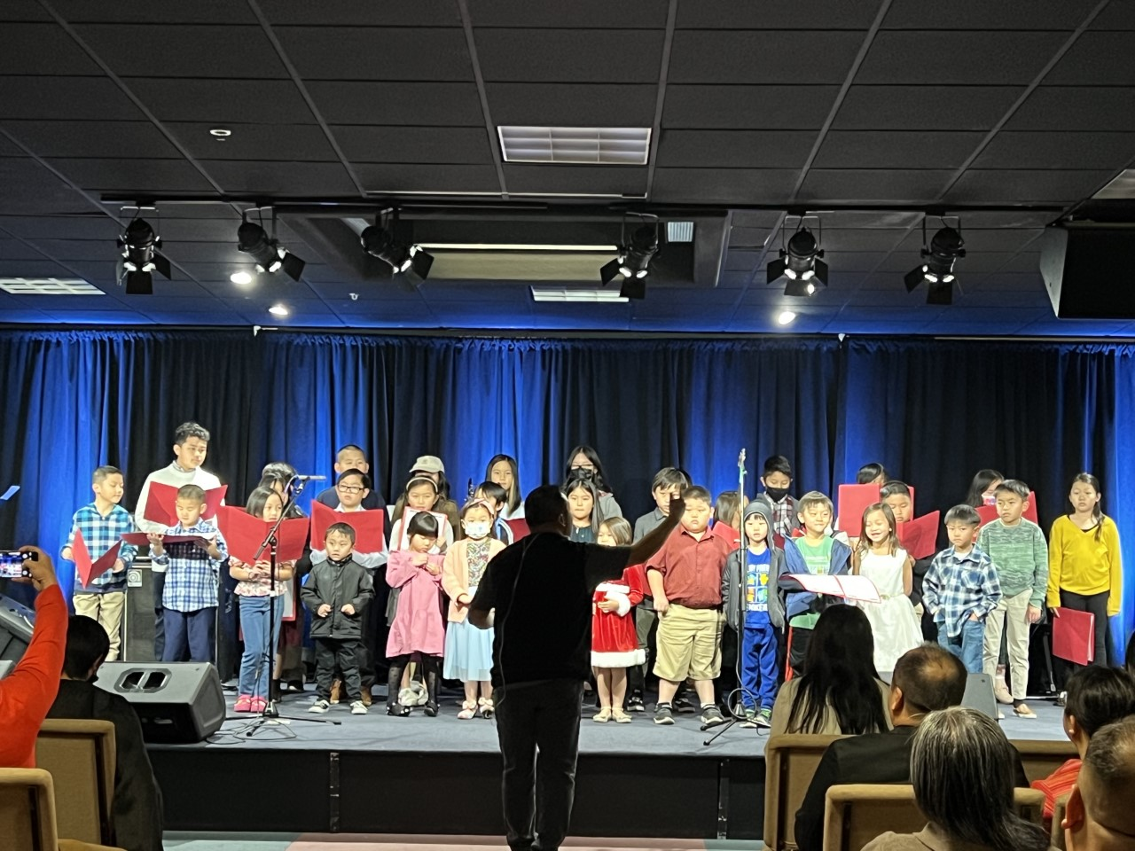
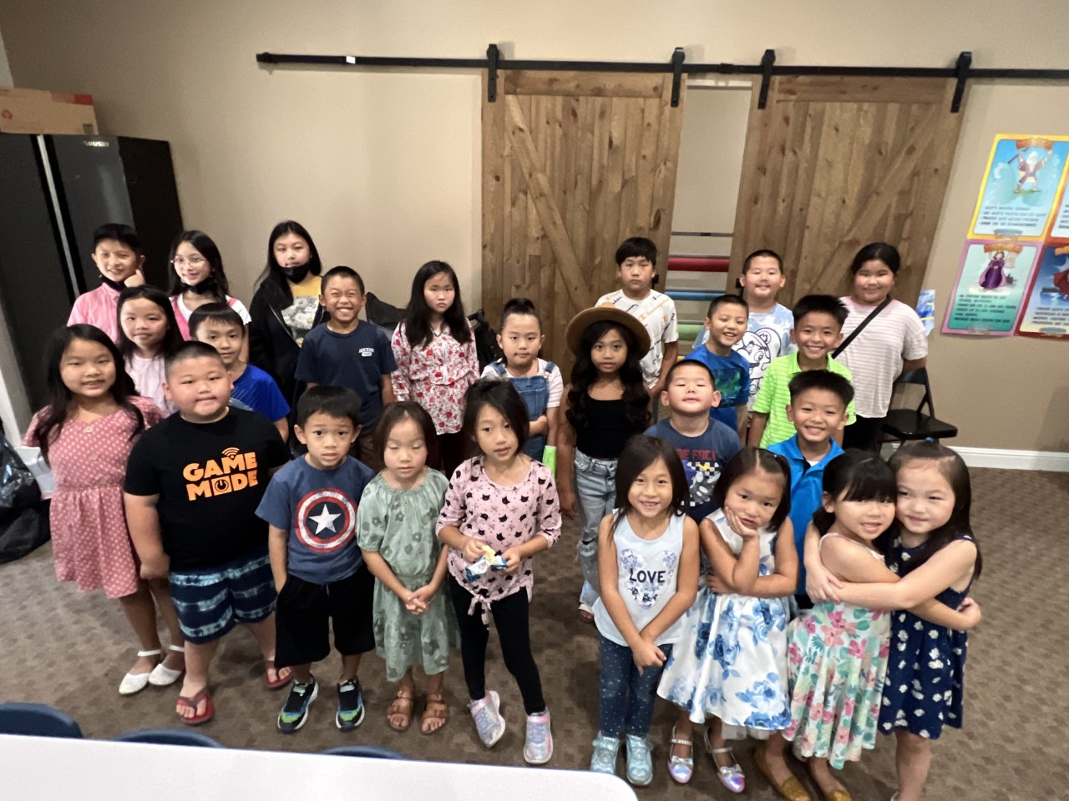
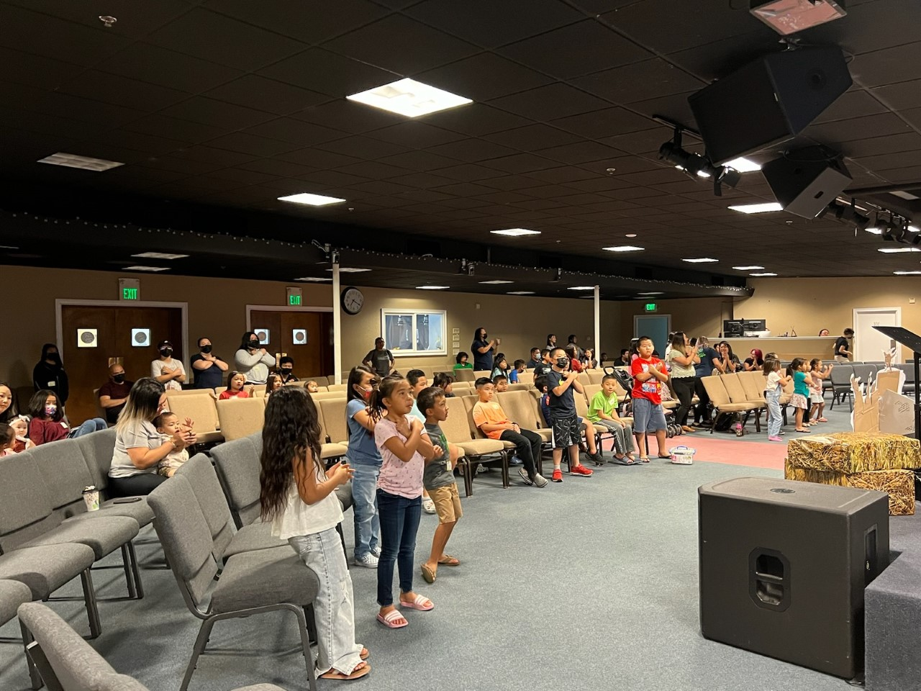

Slide 25
FELLOWSHIP MINISTRY

Slide 26
Young Adults Ministry
Committee Members: Leaders: Jessica Yang, Kayla Moua, Jonathan Vue, Hydaeus Vang, Isabelle Kue
Vision Of Ministry: Our vision for the young adult ministry is to provide a sense of belonging for the young adults, as well as to build up our relationships. Our focus also includes encouraging young adults to come back to the church and strengthen their relationship with God and his people.
Theme: Fellowship
Summary of Activities: Book Study, Board game night, Arts and Craft Night, Bowling night, Boba and Movie Night, Korean BBQ Night, Salt and Light Conference (20 attendees), BBQ at the park to welcome the youth transitioning into YA, Potluck dinner, Karaoke night, Pumpkin patch and maze, Night of Worship: Alive in Him.
Overall areas of success: They got to grow and get to know each other’s faith and walk with Christ. Many opportunities were opened for them to be vulnerable with one another as they learned to keep God close in their discussion and their activities.

Slide 27
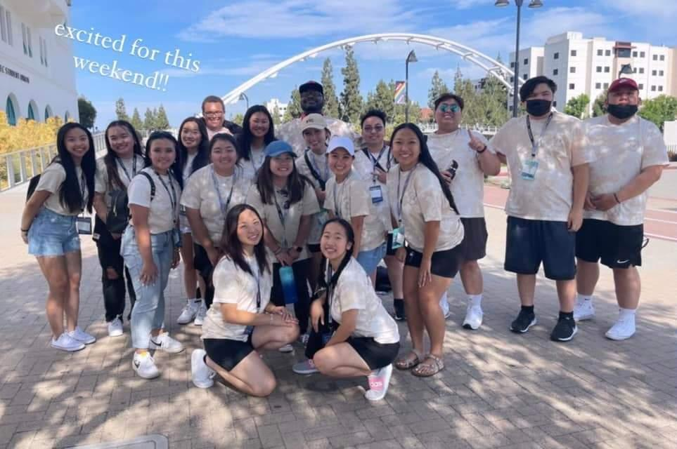

Slide 28
Risen Hope Church Plant Team

Slide 29
Usher Ministry
Coordinator: Lue (Louie) Thao
Summary: This past year we had our counters train with Vameng Thao to learn the recording process. We trained many new ushers on their ushering duties: passing collection bags and ushering people to their seats. It was productive when people showed up for their duties but it seemed like I was working a lot. But as a coordinator that is what I do.

Slide 30
Praise and Worship Ministry

Slide 31
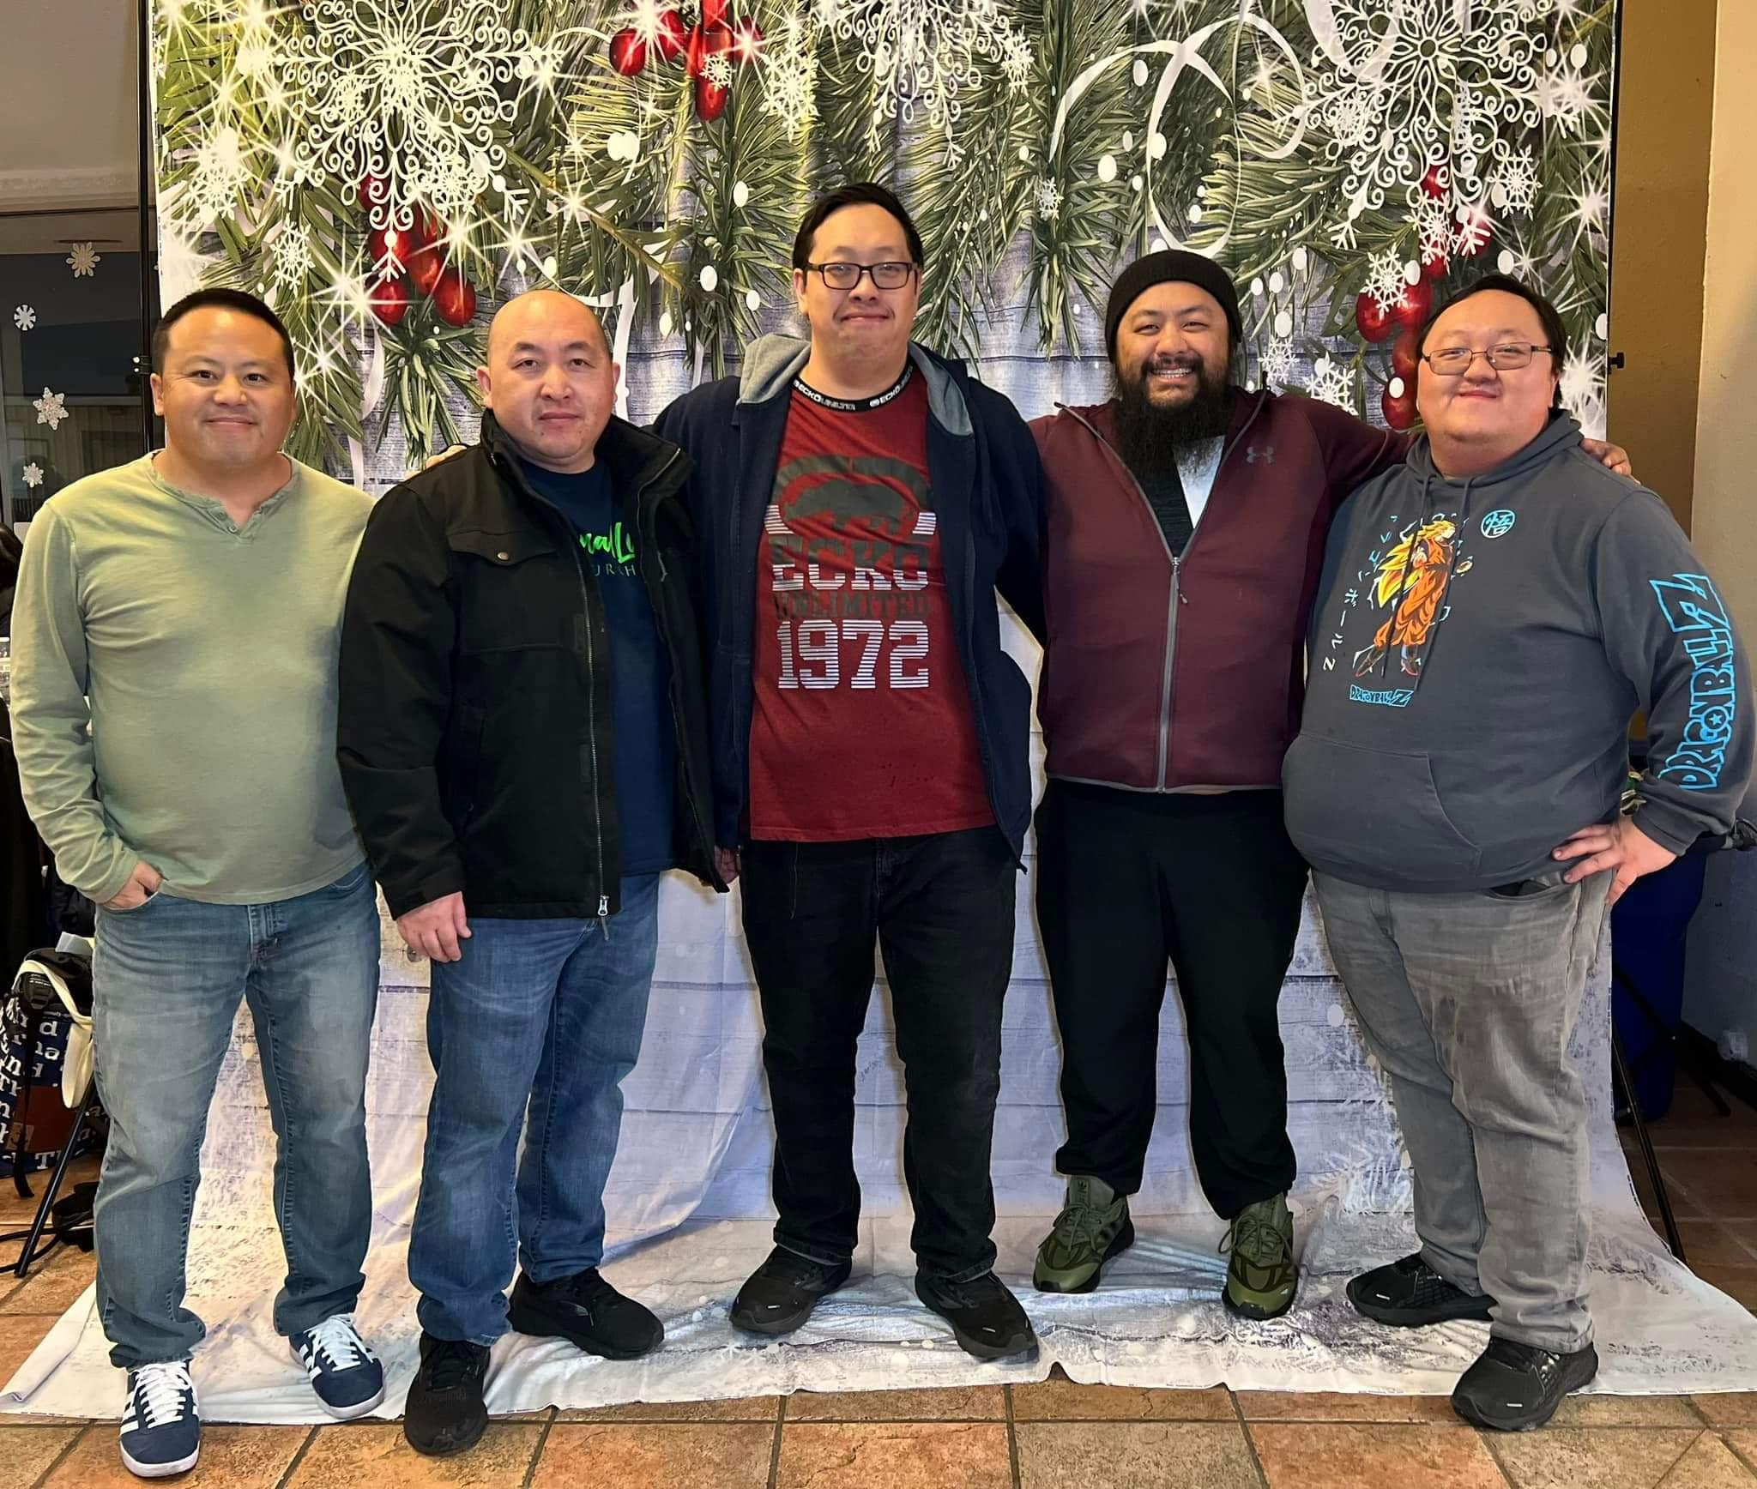

Slide 32
AUDIO VISUAL
Committee Members:Peng Her and Michael Yang
Vision Of Ministry: The vision of the AV ministry is to support other ELC ministries on and off campus which can free ministry leaders to focus on their ministry and not the technology. This can be accomplished by installing equipment that simplifies
Theme: AV is a ministry that provides support.
Summary of Yearly Activities/Number of Attendees:
AV ministry has provided support for both ELC Worship services (Hmong, English) every Sunday in 2022. Furthermore, AV provided support for all the worship team practice sessions throughout 2022.
English worship team on Tuesday night at 7pm – 9pm
Hmong worship teams on Thursday from 7pm-9pm
Night of Worship
Heavenly Harvest
Special occasions throughout 2022.
Provided audio support for the following outdoors event. Audio equipment was transported and set up: Annual picnic – Ancil Hoffman Park and Thanksgiving Diner – Citrus Heights Community Center
Overall areas of success: Sunday Services has been operating as planned. Volunteers new to AV are given an opportunity to run both Audio and Video during services. Setup outside of ELC continues to be coordinated and led by Peng and Michael.
Ministries have been great at communicating their AV needs this year. AV has been able to better prepare for ministry events.

Slide 33
Security
Mission and Vision of Ministry: We are committed to providing safety and security services for all who worship at Eternal Life Church (ELC). The primary purpose of this Ministry is to maintain a peaceful, safe environment which is conducive to teaching, learning, working, living, and sharing in the Word of God.
Summary of Yearly Activities: This year the campus was fully opened for in-person services, which called the team to resume our normal duties. This year other policies are also being put together by this ministry team for review and approval as we move into the new year pertaining to emergencies, medical or other. In 2022, we continued to experience cases of trespassing and theft. This year provided opportunities for us to meet, get to know and witness to the homeless in and around our campus. There were homeless individuals that came to our campus for food and water. We provided them food, water, words of encouragement and prayers. Furthermore, we requested for a few more cameras this year to cover the main office area where the ushers count and to cover the entrance leading to the pastors’ offices and restrooms for enhanced security. We provided safety and security services for Vocational Bible Camp, Easter, Pastor Appreciation, Heavenly Harvest, Turkey Drive and Clothing Give-Away, Mission Conference, Night of Worship, Christmas Dinner and Appreciation Dinner.
Overall areas of success: God was able to use us to serve each other and our congregation without incident this year.

Slide 34
